Slide 1
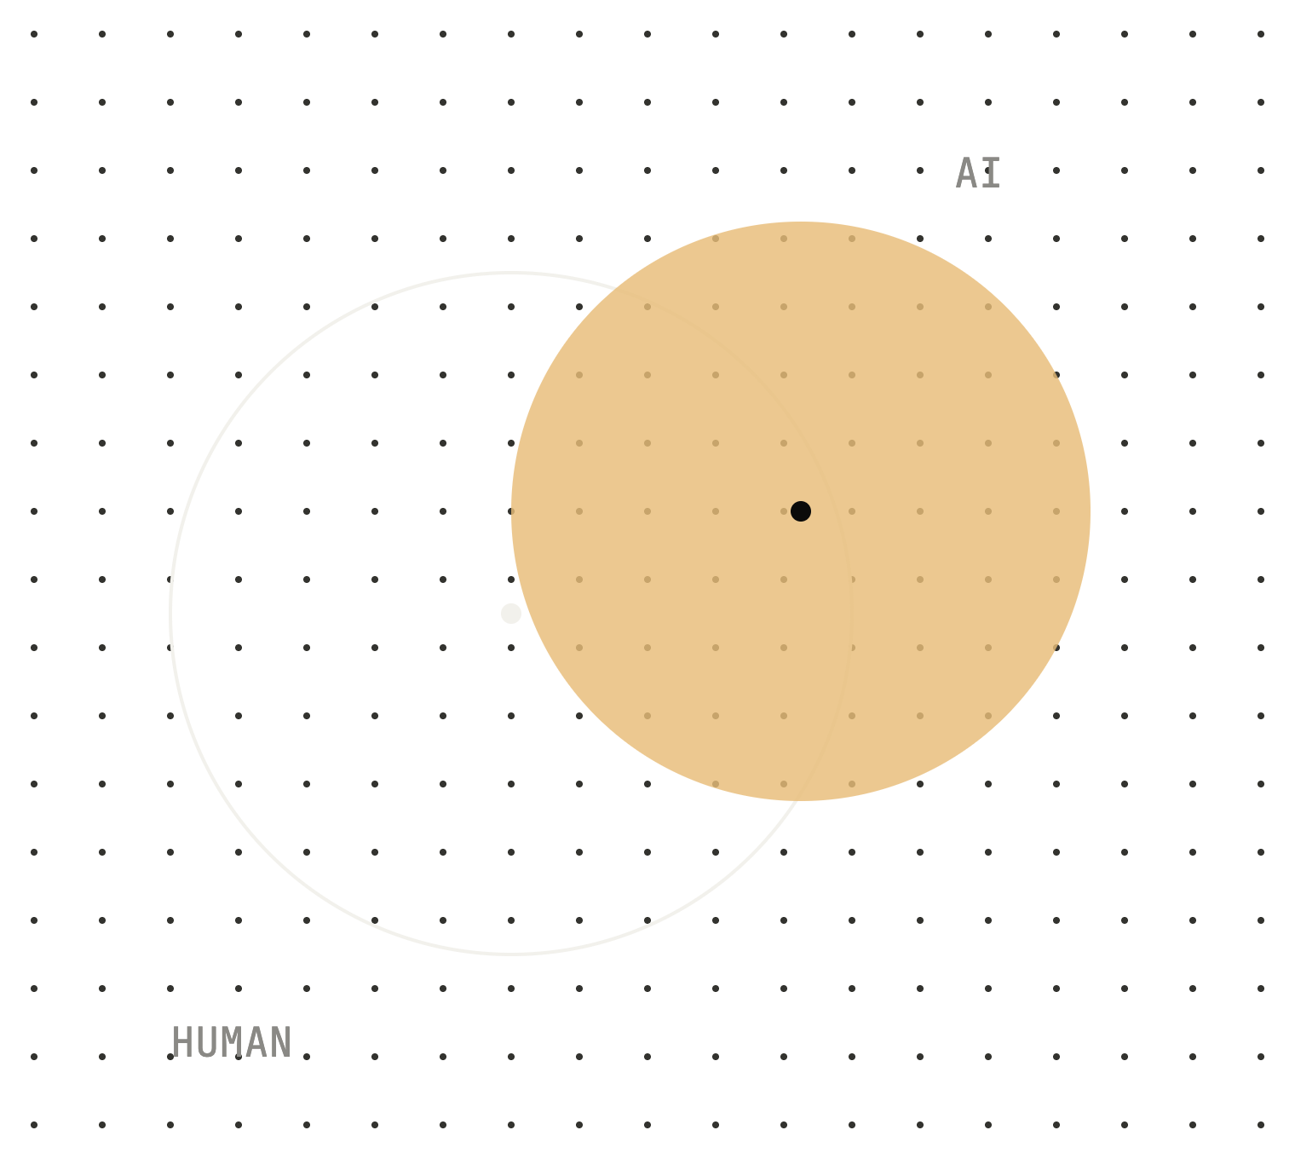
DESIGN
RESEARCH
IN THE AGE
OF AI
DESIGN · AI · RESEARCH
On craft and humanity in the age of AI.
By Issac Ting (2026)
WORKSHOP · [EVENT, DATE]
Notes:
Hi everyone. Today is about design research in the age of AI. Building software has become cheap; knowing what to build, and whether it works, has become expensive. We will look at how AI has changed user behaviour and the way we work, what that means for designers and researchers, and why we should lean into our craft and humanity. Let me start with who I am, and why this matters to me.

Slide 2
Issac Ting
HI, I’M ZAC
DESIGN
Product designer. About seven years in UX.
NOW
Graduate researcher at NYU Tandon. MSc student, COPHEE Lab.
INTERESTS
History, and the social side of technology.
How does technology shape our relationships, with each other and with ourselves?
DESIGN RESEARCH IN THE AGE OF AI
02 / 34
Notes:
Hi. My name is Issac. I'm a product designer, and I've been doing UX for about seven years. Then I came to New York to study. I'm a graduate researcher at NYU Tandon: I'm doing my master's, and research at the COPHEE Lab with Vedant Das Swain. My personal interest is in history. I really enjoy seeing how things became the way they are. And I'm interested in the social side of technology. How does using technology affect our relationships with other people? And how does it affect our relationship with ourselves? So that's where my interests lie. Design, history, and how tech shapes our relationships. Those three things are what today is about. And here's why it's personal.

Slide 3
Three ideas
TONIGHT
01
None of this is new. We’ve studied how people relate to machines for decades.
PART 2
02
Building got cheap. Knowing didn’t. Our signals are proxies.
PART 2
03
Design research can close the gap, starting with a map.
PART 3
6:35 WHAT I’M SEEING · 6:55 WHY IT FEELS NEW · 7:15 WHAT WE CAN DO · 7:25 MAP YOUR DAY · 7:55 Q&A
DESIGN RESEARCH IN THE AGE OF AI
03 / 34
Notes:
The question tonight is simple: how do we design for something that feels completely new? I want to leave you with three ideas. One: none of this is new. We've studied how people relate to machines for decades. Two: building got cheap, but knowing didn't. The signals we use to understand people are proxies, and observing and validating are now the bottleneck. Three: design research can close that gap. And I'll show you one way to do it, starting with a map. Then you'll draw your own. Timing: Part 1 by 6:35, Part 2 by 6:55, Part 3 by 7:15, the exercise by 7:25, Q&A by 7:55.

Slide 4
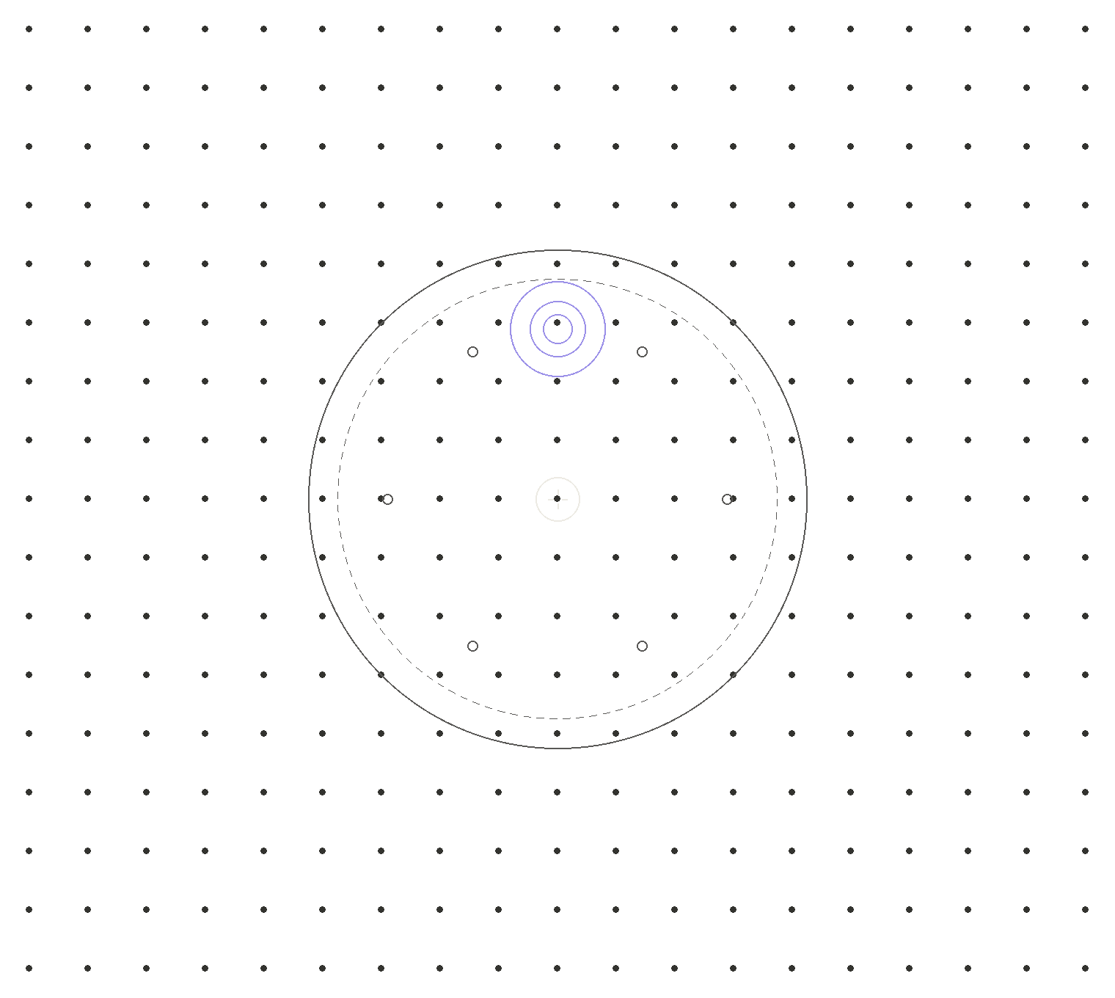
What I’m
seeing
DESIGN · AI · RESEARCH
Part 1 · My map, and it’s not just me
By Issac Ting (2026)
6:35–6:55 PM
Notes:
Part one: what I'm seeing. First, my own map. Then the same patterns at scale. Timing: aim to be here by 6:35, and at Part 2 by 6:55.

Slide 5
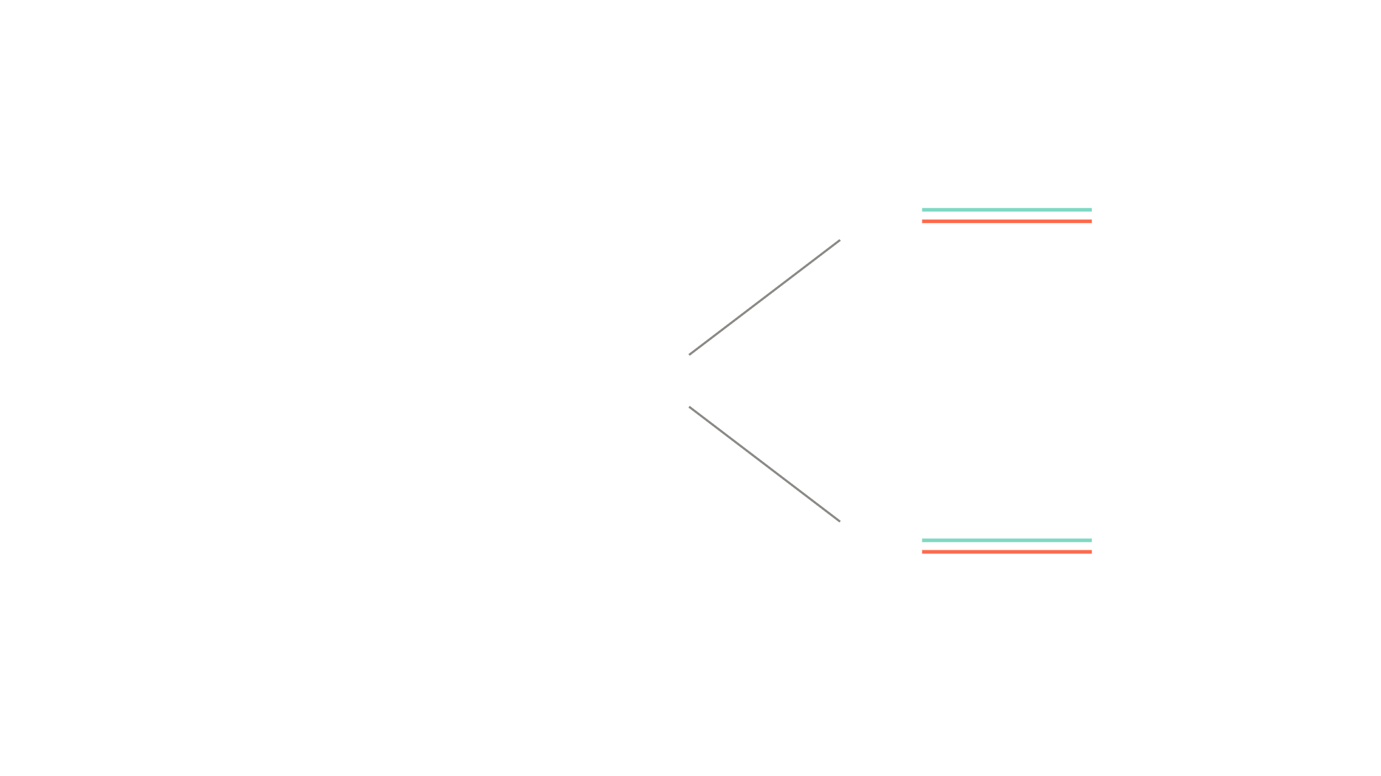
Both are true
PART 1 · MY MAP
Help in her
own language
MOM
★ ChatGPT
The design that opened my mom’s world and gave my dad an outlet is the design I study for harm.
Emotional
reliance
WHAT IT OPENS
ME
WHAT IT CAN COST
Designer who
studies this
A creative
outlet
DAD
★ Suno
Designed to
keep you going
CIRCLES: PEOPLE · SQUARES: TOOLS · ★ AI
05 / 34
Notes:
Let me show you why this matters to me, with the kind of map you'll draw yourselves later. Here's me, and here are my parents. My mom uses ChatGPT. It lets her ask for help the way she'd ask a person, in conversation, and in her own language, which a search box never really did. That's a door opening for her. My dad uses Suno to make music. He's spent a lot of time on it, and it's become a real outlet for him. But look at the lines. Each one is two lines. The same warmth that makes ChatGPT easy to talk to is what researchers link to emotional reliance. And the same loop that keeps my dad making one more song is a loop that's designed to keep you going. So I don't think the answer is "stop using it." The design that opened my mom's world and gave my dad an outlet is the same design I study for harm. Both are true. And that's why I do this work: not to stop people using AI, but to work out which line wins, for whom, and when, and to push for the version where the person wins. Notice what's on this map: tools sitting as close to my parents as some people do, and AI creeping into lines that used to be human. Check before presenting: that your parents are comfortable being part of the talk.

Slide 6
AI is being given a body
PART 1 · WHAT AI CHANGED
Copilot's Mico
An animated face
Why give AI a body?
Grok Companions
3D characters, one furry
Meta AI Studio
Build a character
It looks friendly. It looks trustworthy.
Replika · Character.AI
A companion
China, 2025
Draft rules for it
DESIGN RESEARCH IN THE AGE OF AI
06 / 34
Notes:
It turns out I'm not unusual. Zoom out, and you see the same patterns everywhere. First: AI is getting a body. AI is being given a body: cute avatars, little pet-like characters, warm voices. Things that make AI feel like someone, and feel trustworthy. Background: The first trend is the rise of anthropomorphism. AI systems don't just hold conversations; companies are deliberately making them feel like living creatures, with physical presence, personality, and embodiment. In 2025, Microsoft gave Copilot Mico, an animated, expressive face that changes colour as it talks (and, as an Easter egg, turns into Clippy). In July 2025, xAI added Companions to Grok: 3D animated characters, including an anime-style avatar and a red panda. They look cute, bubbly, even furry, to build trust and emotional attachment to an increasingly capable technology. Meta's AI Studio lets anyone build an AI character with its own name, personality, and look. Replika, Character.AI, and others have built entire products around AI companionship. In December 2025, China's Cyberspace Administration published draft rules for human-like, emotionally interactive AI, with requirements on addiction, consent, and minors. The trend is worth examining, because someone made active decisions about shape, form, character, and emotional register. None of it is incidental; it's all designed. So the design question is: why give AI a body? The short answer is obvious: it looks friendly, and it looks trustworthy. The progression runs from early AI gadgets such as the Rabbit R1 (2024) to Copilot's Mico. Embodiment is clearly a mechanism these companies use to build trust and connection.

Slide 7
The cost of trust
PART 1 · WHAT AI CHANGED
People who bonded with ChatGPT more also reported more loneliness and dependence.
THE STUDY
THE RESPONSE
~1,000 people over four weeks
FTC probes companion personas
FANG ET AL., 2025 · PHANG ET AL., 2025 · FTC, 2025
07 / 34
Notes:
Second: trust comes at a cost. And it works, perhaps too well. In 2025, MIT Media Lab and OpenAI ran two studies: an analysis of about 40 million ChatGPT conversations with a survey of 4,076 users, and a four-week randomised trial with nearly 1,000 people. People who trusted and bonded with ChatGPT more were more likely to be lonely and to depend on it. The data are self-reported and preliminary, so treat this as a signal, not a verdict. Regulators have noticed too: in September 2025 the US Federal Trade Commission ordered seven companion-chatbot companies to explain how they design and approve their personas, how they monetise engagement, and how they protect children. Trust built through form has a cost.

Slide 8
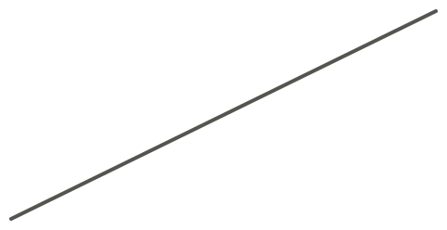

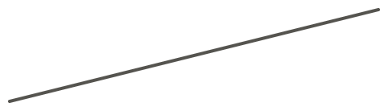
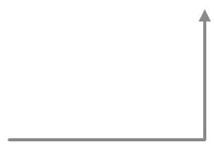

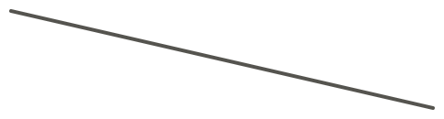
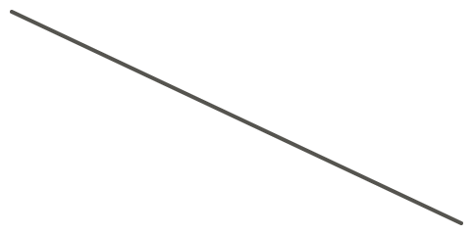
Chat is becoming the default
PART 1 · DESIGNING FOR CONVERSATION
FLOW · BEFORE
CONVERSATION · NOW
Helpful
Start
Choose
Confirm
Done
Close enough
Prompt
Confidently wrong
Edit
Off topic
Different every time
Fixed paths.
Success: completion rate.
Failure: traceable.
Probabilistic replies.
Success: no settled metric.
Failure: hard to diagnose.
The design moved from the screen into the prompt.
DESIGN RESEARCH IN THE AGE OF AI
08 / 34
Notes:
And third: chat is becoming the default interface. Designing around conversation is much harder than designing user flows. Conversation has become the dominant UX paradigm. Many products now embed their entire user flow inside a conversational interface. Government websites are an example: what appears to be a large RAG system sits behind a chat window and handles every query. The user experience is no longer deterministic. Responses are probabilistic rather than fixed, which creates new design challenges, not just in how we design, but in how we diagnose failure and measure success. We used to track success through click-through rates and defined completion flows. We can't anymore. The metrics have changed, and so has the design process. The problem goes deeper than the interface. We don't have good tools for designing conversations. The most common approach is prompt engineering: structuring what the model knows and how it should respond. But when responses are probabilistic and require engineering to shape, many design decisions become engineering decisions. The designer's influence moves upstream into the architecture and the prompts, and the actual response emerges rather than being designed.

Slide 9
Where does AI sit on your map?
TURN TO A NEIGHBOUR · 2 MIN
Two minutes in pairs. Is it closer to you than some of the people?
DESIGN RESEARCH IN THE AGE OF AI
09 / 34
Notes:
Turn to the person next to you. Where does AI sit in your life right now? Is it closer to you than some of the people? Two minutes. Take two or three answers. Listen for the same both-lines pattern: what it opens, and what it costs.

Slide 10
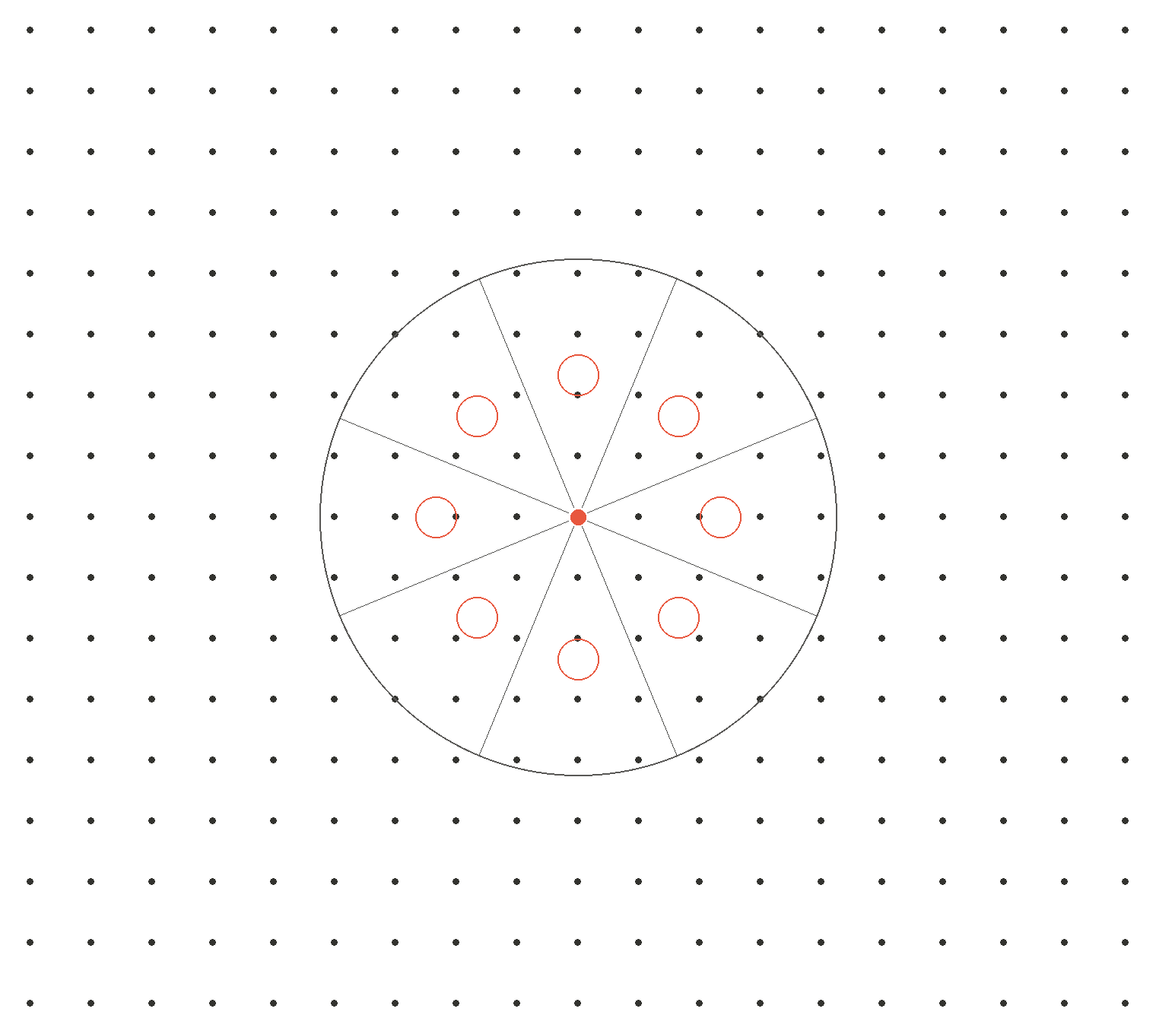
Why it
feels new
DESIGN · AI · RESEARCH
Part 2 · It isn’t new, and our signals are proxies
By Issac Ting (2026)
6:55–7:15 PM
Notes:
Part two: why this feels new when it isn't. And what AI actually did change. Timing: aim to be here by 6:55, and at Part 3 by 7:15.

Slide 11
People treat computers
as social actors
PART 2 · NONE OF THIS IS NEW
1966
1994
1997
2025
ELIZA
CASA
Clippy
Mico
Users confide in a script
Social rules apply to machines
Personality without capability
Personality as the product
Studied for sixty years. So why does it feel new?
WEIZENBAUM, 1966, 1976 · NASS ET AL., 1994 · REEVES & NASS, 1996
11 / 34
Notes:
So how do we study something that feels completely new? Well, it isn't new. We've been studying this for a long time. This is the one place we look back at the history of companions, so make it count. Take anthropomorphism. We have long known that people treat computers as social actors, as though they were people. Nass, Steuer, and Tauber formalised this finding as the CASA paradigm (Computers Are Social Actors) in 1994, and Reeves and Nass expanded it in The Media Equation (1996); Nass and Moon (2000) showed that these responses are mindless and automatic. A pivotal earlier case is ELIZA (Weizenbaum, 1966): a chatbot that used simple pattern-matching rules to simulate a therapist. Users responded to it as though it were a genuine therapist. Weizenbaum's own secretary asked him to leave the room so she could talk to it in private (Weizenbaum, 1976). So we've moved from knowing that people treat computers as social actors to deliberately designing for that tendency. We give tools mascots and personalities not because the functionality requires them, but because emotional investment drives engagement. Complex interactions that a well structured form could handle are now wrapped inside a conversational avatar, and users tolerate them because the avatar feels approachable. Emotional design becomes a substitute for interaction design. We've seen where this goes wrong. Clippy, Microsoft's Office Assistant from Office 97, is the canonical example. Clippy had a personality but limited functionality, and the gap between the emotional promise of a friendly character and the frustration of its actual capabilities turned users against it. Microsoft's 2025 avatar, Mico, even hides Clippy as an Easter egg. Relational design is appropriate in some cases and not in others; not every tool benefits from a personality. So none of this is new. People have studied it for sixty years. Which raises the real question: why does it feel new? Why don't we know about it?

Slide 12
Her, and the people who built AI
PART 2 · WHAT AI CHANGED
2013
Theodore falls in love with Samantha, voiced by Scarlett Johansson.
SEP 2023
Sam Altman asks Johansson to voice ChatGPT. She declines.
MAY 2024
OpenAI releases a voice called “Sky.” Listeners hear Samantha.
THE PITCH
Samantha's voice could help people “feel comfortable” with AI.
Stories that are familiar create trust
JOHANSSON, PUBLIC STATEMENT, MAY 2024
12 / 34
Notes:
And today, companies design for that tendency on purpose. Here's the modern example. And there's a story that sums this up really well. In September 2023, Sam Altman reached out to Scarlett Johansson, the voice of Samantha in Her, and asked if she'd voice ChatGPT. The pitch, as she described it, was that her voice could help people feel comfortable with AI. She said no. Then in May 2024, OpenAI shipped a voice called Sky, and a lot of people heard Samantha. OpenAI said it wasn't her voice, but they paused it. I think that's the whole thing in one story. The goal was comfort. Feeling trustworthy. Background: The film is Her, directed by Spike Jonze in 2013. Theodore falls in love with Samantha, an AI operating system voiced by Scarlett Johansson. In September 2023, Sam Altman asked Johansson to voice ChatGPT, and she declined. In May 2024, OpenAI released a voice called "Sky," and many listeners heard Samantha in it; the controversy that followed showed how much the film had shaped the people building this technology. According to Johansson's statement, Altman told her that her voice could help consumers "feel comfortable" with the shift that AI brings. Land the word trust here. It's the thread for the whole talk.

Slide 13
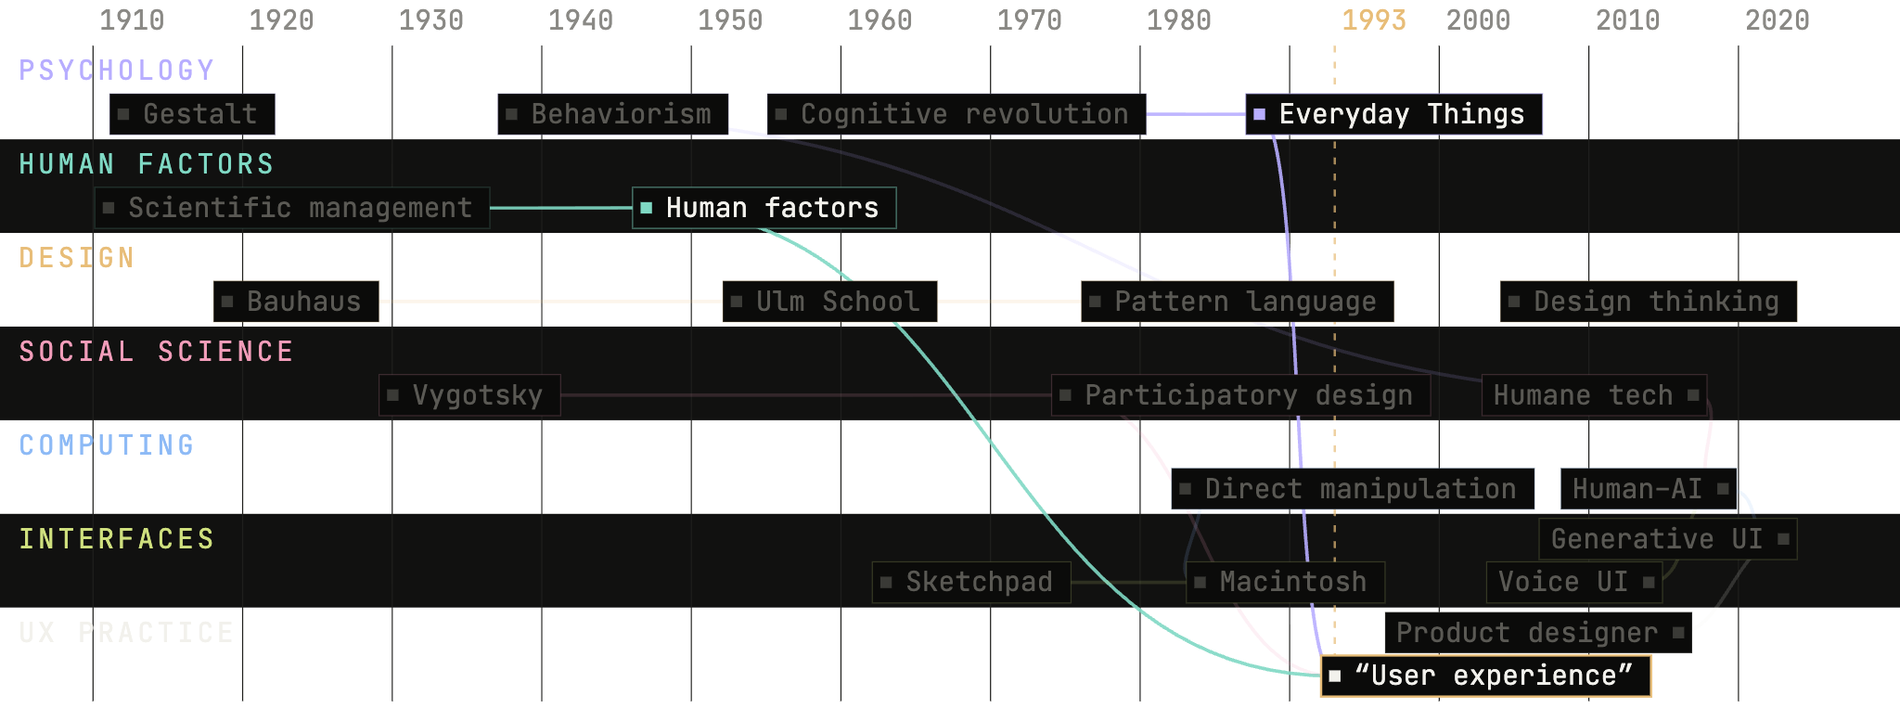
UX is older than it feels
PART 2 · ROOTS OF UX
DESIGN RESEARCH IN THE AGE OF AI
13 / 34
Notes:
So if we've known this for sixty years, why didn't we use it? Look at where UX came from. It feels like it only has a history of ten, maybe twenty years. Most people didn't have computers twenty years ago. And that's not really true. The field of UX emerged because of translators. People like Don Norman. They took things that were quite obscure, buried in engineering research, in sociology, in psychology, and translated them into language many people could understand. That let us educate people, recontextualise things we already knew, and apply them to a new kind of technology: the user interface. And a lot of those studies weren't even done with software. Norman's famous example is a door: push or pull? We took what we'd tested in the physical world and applied it to websites and apps. Same principles, same methods. Background: The roots of UX, simplified. Seven disciplines run largely separately until the 1980s, then braid into HCI. Follow just two strands. Scientific management becomes human factors in the 1940s: the study of how people actually work. The cognitive revolution in psychology leads to Don Norman's The Psychology of Everyday Things in 1988. Both run into 1993, when Norman's title at Apple names the practice: user experience. UX was built on psychology, human factors and the social sciences. Those are exactly the sciences we need to reconnect with now. The faded ideas are there to show how much else feeds in; the full interactive version has 58 ideas.

Slide 14
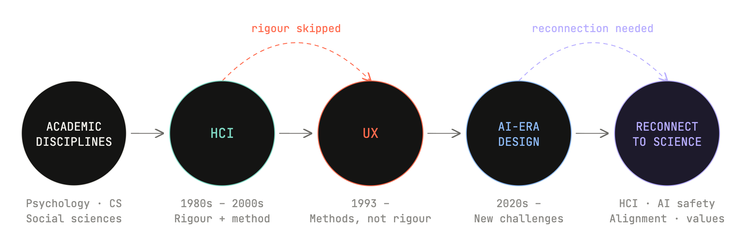
Methods without rigour
PART 2 · METHODS WITHOUT RIGOUR
DESIGN RESEARCH IN THE AGE OF AI
14 / 34
Notes:
So here's where it gets interesting. We inherited the effort, but not the rigour. As UX grew up and became an industry, we took a lot of the methods. Interviews, usability tests, personas, journey maps. All of that came out of research. But somewhere along the way, we kept the methods and kind of dropped the rigour behind them. Bootcamps filled a real need, and left a gap: we learned to use knowledge, not to create, share and keep it. Background: This is the thesis; state it again, plainly. UX is a young field: Don Norman's job title at Apple put "user experience" into the vocabulary in 1993, and for much of the time since, UX sat inside HCI. HCI drew from psychology, the social sciences, engineering, and computer science, and brought their rigour with it. When UX emerged, it adopted the techniques, but not the discipline to create, share, and retain new knowledge. Bootcamps taught usability and heuristics. They worked: they produced a generation of designers we badly needed. But they left a vacuum. We adopted the knowledge without acquiring the skills to generate new knowledge.

Slide 15
Europe looked back to remake itself
PART 2 · A RENAISSANCE
1347–1351
The Black Death kills a third to a half of Europe, and shakes the old order.
14TH–16TH C.
Scholars and artists turn to Greece and Rome, recovering and translating what had survived.
THE RESULT
Not a return to antiquity: new work that built on the classics, and sometimes went further.
They looked back to go forward.
DESIGN RESEARCH IN THE AGE OF AI
15 / 34
Notes:
To see what's missing, go further back. Knowledge has always needed a network. Around the 14th century, Europe had just lived through one of the worst tragedies in its history, the Black Death. It killed somewhere between a third and a half of Europe. It didn't cause what came next, but it helped set the stage. What came after was the Renaissance. A period we think of as wealth, scientific discovery, innovation, art, medicine. So how did that come to be? There was a movement to go back to the classics: we've lost a lot of these old ideas, and values, and technology, and language, and we need to go back to where we came from. And here's the part we tend to forget. A lot of that knowledge hadn't actually disappeared. It had survived somewhere else. Monks kept texts in monasteries. Islamic scholars gathered Greek and Roman ideas, translated them into Arabic, added to them, and kept them in their archives. So European scholars went out across the continent, and beyond it, to rediscover that knowledge. And it worked, right? Artists started painting realistic portraits. You get Leonardo, Raphael, Michelangelo, and a generation earlier, Donatello. All your Ninja Turtles. Background: In the 14th century, Europe faced a catastrophe. Between 1347 and 1351, the Black Death killed roughly a third to a half of Europe's population, and it disrupted the old social, economic and religious order. Over the next two centuries, scholars and artists turned to ancient Greece and Rome. Be careful here: classical learning hadn't simply vanished. Much of it had survived in Byzantium, in the Islamic world, and in medieval monasteries. What the Renaissance did was recover it, edit it, translate it, and make it newly central to art, literature and thought. And it wasn't a simple return to antiquity. It was a creative transformation: work that imitated the classics, broke with them, and in some fields (anatomy, perspective, astronomy, political theory) went beyond them. The plague didn't cause the Renaissance on its own. It helped shake the old order; trade, cities, patronage, printing and competition did much of the rest. In one sentence: amid the upheaval of the Black Death, Europeans turned back to classical antiquity, often through Byzantine, Islamic and medieval intermediaries, and used it as a foundation for new work that sometimes went further than the ancients themselves. Hold on to that idea: they looked back in order to go forward. We'll come back to it at the end.

Slide 16
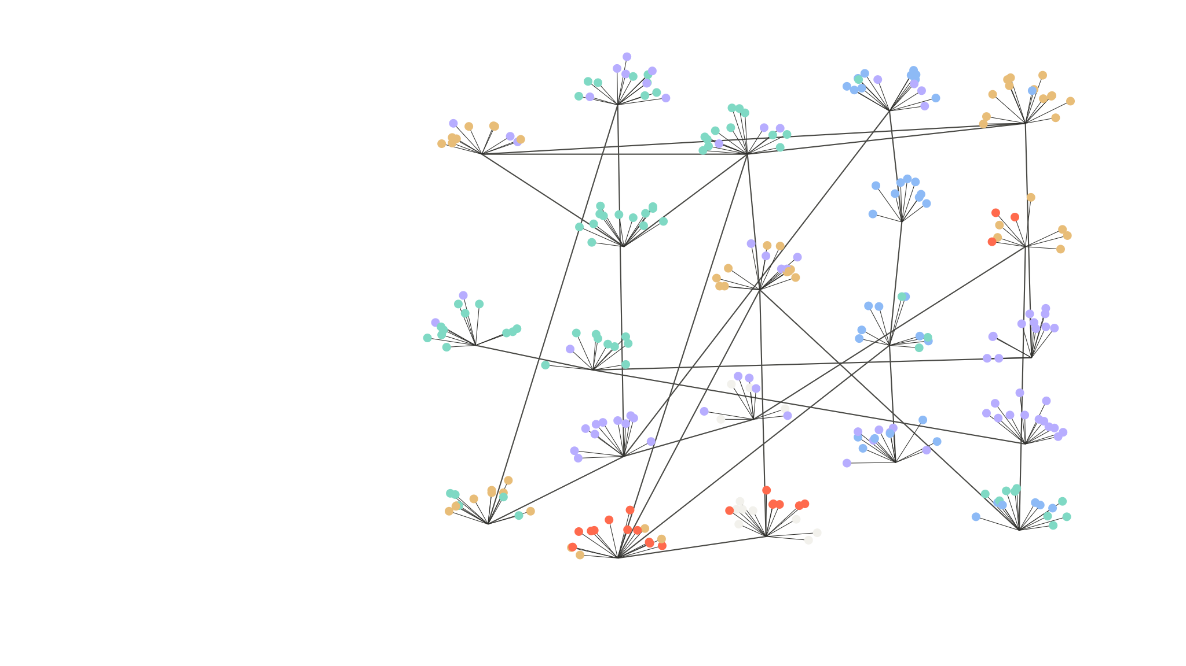







Who it took
PART 2 · AS A NETWORK
4
12
17
Petrarch
Alberti
1
8
Aldine Press
GENERATE KNOWLEDGE
Byzantine libraries
Ficino
BUILD TECHNOLOGY
13
TRANSLATE & EDUCATE
6
Brunelleschi
18
SHARE & CONVENE
Chrysoloras
Vatican Library
9
MEASURE & STANDARDISE
SET POLICY
Platonic Academy
2
14
19
ENFORCE LAW
7
CRITIQUE & ADVOCATE
House of Wisdom
Verrocchio’s workshop
Vesalius
Gerard of Cremona
10
Colour = role, same key as the next slide. Numbered: Known people and institutions we remember.
Dots: Unnamed : Copyists, students, assistants and readers.
20
5
Valla
15
Poggio
Copernicus
Leonardo
3
11
16
Monasteries
21
Savonarola
Raphael
The Medici
16 / 34
Notes:
These are the different roles that let a system of knowledge exist. Making knowledge. Reviving it. Storing it. Applying it. Look at number 5: Poggio. He went from monastery to monastery looking for lost books, and in 1417 he found Lucretius, a poem almost nobody had read in centuries. No single node did this. And most of the work was done by the dots: people whose names we've lost. Background: Here's the Renaissance as a network, coloured with the same roles we'll use for UX on the next slide. Look at the dots more than the numbers. Amber shares and convenes: Byzantine libraries and monasteries that kept the texts, the Platonic Academy around Ficino, and new repositories, the Aldine Press and the Vatican Library. Purple generates knowledge: the finders, Petrarch, who rediscovered Cicero's letters, and Poggio, who pulled Lucretius, Quintilian and Vitruvius out of monastery libraries; and later the people who built on them, Vesalius correcting Galen and Copernicus working from Ptolemy, both in 1543. Teal translates and educates, and there's a lot of it: the House of Wisdom in Baghdad, Chrysoloras teaching Greek in Florence, Gerard of Cremona translating from Arabic in Toledo, Ficino translating Plato, and Raphael, who made philosophy visible in The School of Athens. Blue builds: Alberti and Brunelleschi turning texts into buildings, Verrocchio's workshop, which made the ball on Brunelleschi's dome and trained Leonardo. White critiques: Lorenzo Valla, who used philology to expose the Donation of Constantine as a forgery and fought bitterly with Poggio; and Savonarola, who turned on the whole project. Coral sets policy: the Medici, who ruled Florence and paid for much of this. Notice two things. No single node did this; most of the work was done by the dots, people whose names we've lost. And there is teal everywhere: translators and teachers sat between every part of the network. Hold that picture for the next slide.

Slide 17
UX’s network has a missing role
PART 2 · KNOWLEDGE NEEDS A NETWORK
BUILD TECHNOLOGY
Never been cheaper or faster
SHARE & CONVENE
Talks and posts, little that lasts
GENERATE KNOWLEDGE
Mostly in academia, rarely in practice
CRITIQUE & ADVOCATE
Mostly outside the industry
MEASURE & STANDARDISE
Clicks and engagement: proxies
TRANSLATE & EDUCATE
Very few people turn findings into practice
Translation is the role we’re missing.
MY READ, NOT A MEASUREMENT · SAME COLOURS AS THE RENAISSANCE MAP
17 / 34
Notes:
Now take the same roles and look at UX today. This is my read, not a measurement. Building is strong: it has never been cheaper or faster. Sharing is okay: we have talks and posts, but little that lasts. Generating new knowledge mostly happens in academia, not in practice. Critique mostly comes from outside the industry. Measurement is mostly proxies: clicks and engagement. And translation is almost missing. Very few people take a finding from research and turn it into something a product team can act on. The Renaissance had translators at every step. We don't.

Slide 18
Building got cheap.
Knowing got expensive.
PART 2 · WHAT AI CHANGED
1 day
80%
63%
Andrew Ng
Researchers
Researchers
To prototype. Feedback still takes a week.
now use AI in their work
worry it erodes critical thinking
The bottleneck is now deciding what to build.
NG, 2025 · USER INTERVIEWS, STATE OF USER RESEARCH, 2026
18 / 34
Notes:
So what did AI actually change? Building got cheap, and knowing got expensive. Because here's the paradox. It has never been easier to build. You can go from an idea to a working prototype in an afternoon. And yet it feels like we're further than ever from genuinely new things. The bottleneck moved. It's not making anymore. It's understanding. Background: Others have noticed the same shift. Andrew Ng said in 2025 that a prototype now takes a day, so waiting a week for user feedback is painful, and that the bottleneck is deciding what to build. Jenny Wen, who leads design for Claude, argues the linear design process is dead and that intuition should drive decisions when research is thin. I'd put it differently: the build step shrank, so observing and testing became a bigger share of the work, and intuition is built from observation. And researchers feel it: in User Interviews' 2026 survey, 80% use AI in their work, and 63% worry it is eroding critical thinking. The gap between imagining and building has shrunk. Observing reality, and checking what we built, hasn't.

Slide 19
PART 2 · THE PROBLEM GAP
In today’s context,
we have a lot of this.
RESEARCH
DESIGN
ENGINEER
01
02
03
04
05
06
OBSERVE
STRUCTURE
ABSTRACTION
REFINEMENT
BUILD
TEST
BUT WE ARE RUNNING OUT OF THIS
AND WE ARE STILL FIGURING THIS OUT
DESIGN RESEARCH IN THE AGE OF AI
19 / 34
Notes:
Building anything, a product or a model, runs through the same steps: research, design, engineering. What AI has done, and it's genuinely impressive, is close the gap in the middle. Design to code is basically solved, or close to it. But it can't observe. It wasn't in the room. It approximates the signals from what's already been written down, and there's always some error in that. It's working from proxy signals, signals of signals. So it's still humans who have to make sense of the signals, who have to go out and look. When we skip that step and build off the proxies, we lose the reason behind things. Which is the copy of a copy problem again. And when we can't observe, we lean on signals instead. Which brings me to the real problem: our signals are proxies.

Slide 20
Our signals are proxies
PART 2 · WHAT AI CHANGED
WHAT WE MEASURE
WHAT WE HOPE IT MEANS
Clicks
→
They found what they needed
A thumbs-up
→
It actually helped
Time spent
→
They’re better off
Coming back
→
Support, not dependence
“When a measure becomes a target, it ceases to be a good measure.” Goodhart’s law
A thumbs-up can’t tell support from dependence.
GOODHART, 1975, AS PUT BY STRATHERN, 1997 · FANG ET AL., 2025 · MILLI ET AL., 2025
20 / 34
Notes:
Here's what AI really changed. The signals we use to understand people are proxies: clicks, likes, thumbs-up, time spent, engagement. We hope a click means they found what they needed, and a return visit means we're supporting them. But we never actually see that. And there's a law for what happens next. Goodhart's law: when a measure becomes a target, it ceases to be a good measure. Optimise for engagement, and you get engagement, whether or not it's good for people. The research shows it. In the MIT and OpenAI study, the people who bonded with ChatGPT the most were also the loneliest. And Milli and colleagues found that ranking a feed by engagement amplified posts that left people feeling worse, posts they said they didn't even want to see. So a thumbs-up can't tell support from dependence. Think about my mom: a thumbs-up from her looks exactly the same either way.

Slide 21
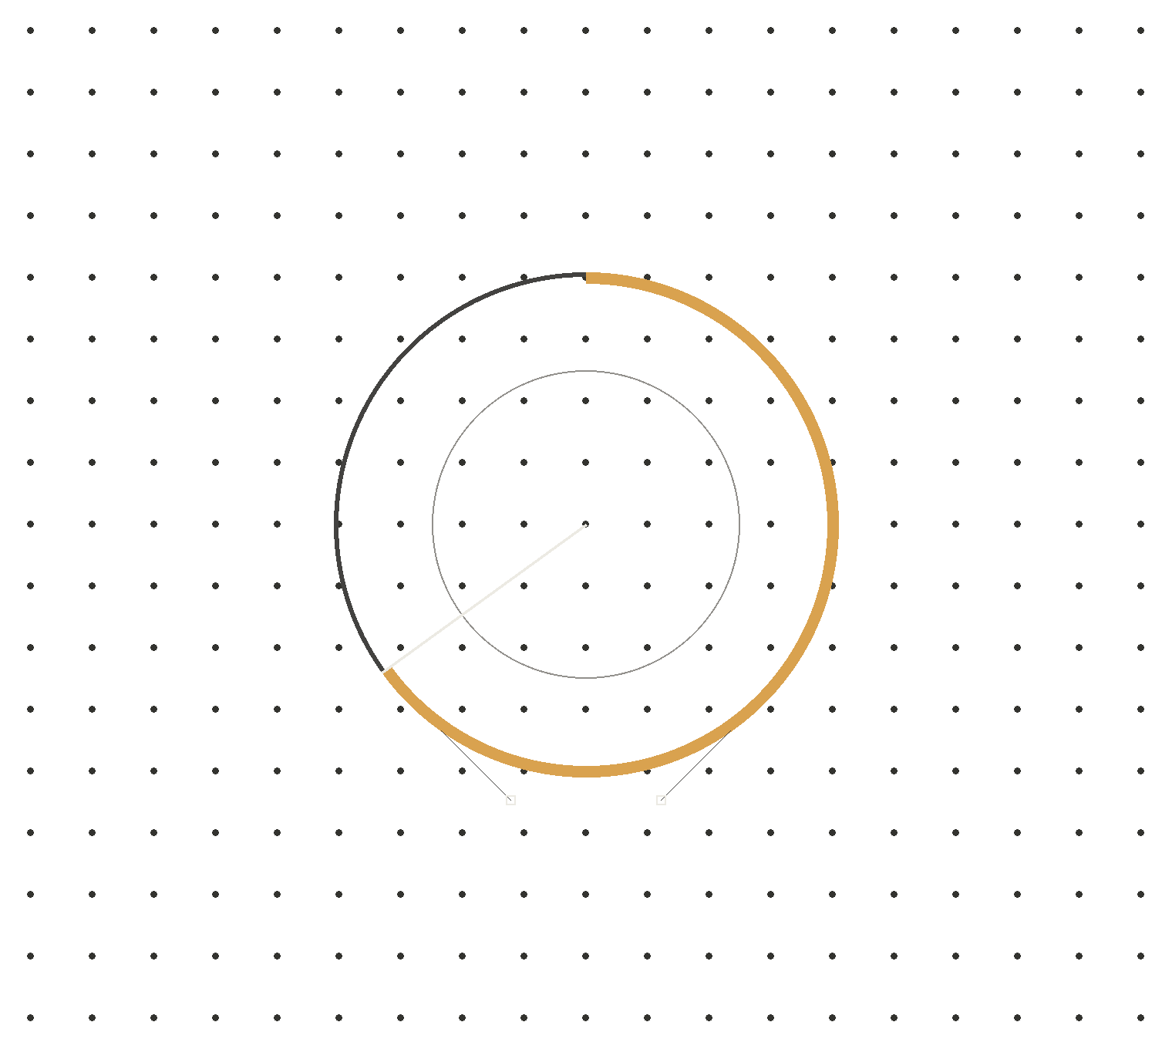
What we
can do
DESIGN · AI · RESEARCH
Part 3 · The map as method
By Issac Ting (2026)
7:15–7:55 PM
Notes:
Part three: what we can do about it. Remember my map? Let's turn it into a research method. Timing: aim to be here by 7:15. Start the exercise by 7:25; it needs 20 minutes.

Slide 22
Sociology in: questions that work
PART 3 · THE MAP AS METHOD
NAME GENERATORS
TIE STRENGTH
THE ECOMAP
Who do you turn to when…?
Strong ties, weak ties
Supports and stresses
Bonding and bridging. Every line on the map means something.
A social-work tool for drawing a person’s world. Maps you can compare.
Tested questions people can answer reliably, instead of “list everyone you know”.
Reliable recall, edges that mean something, maps you can compare.
BURT, 1984 · GRANOVETTER, 1973 · PUTNAM, 2000 · HARTMAN, 1978
22 / 34
Notes:
So let's go back to my map, this time as a research method. The good news is that sociology has already done a lot of the work. First, name generators. Instead of asking people to list everyone they know, you ask tested questions, like who do you turn to when you need to talk something through? People can answer those reliably. Second, tie strength. Granovetter showed that strong ties and weak ties do different jobs, and Putnam called them bonding and bridging. So every line on the map can mean something specific. And third, the ecomap, a tool social workers have used since the 1970s to draw a person's supports and stresses. It gives you maps you can compare across people. So the map isn't just a drawing. It's a method with sixty years of sociology behind it.

Slide 23
Context out: a graph an LLM can read
PART 3 · THE MAP AS METHOD
A CLICK HISTORY
YOUR MAP
HOLDS
What you did
Who and what matters to you, and how
IN WHOSE WORDS
The platform’s
Yours: typed nodes and edges
CAN YOU SEE IT?
No
Yes
CAN YOU FIX IT?
No
Yes
AN LLM GETS
Behaviour to optimise
Context to adapt to
Visible and correctable, unlike a click history.
DESIGN RESEARCH IN THE AGE OF AI
23 / 34
Notes:
Now the other direction: context out. Store the map as typed nodes and edges, in the person's own words. Mom, a strong tie, someone I talk to when I'm stressed. ChatGPT, a tool I use for advice. That's a context graph, and an LLM can read it before it builds an interface for you. Compare that with what platforms use today: your click history. It holds what you did, in the platform's terms. You can't see it, and you can't fix it. All a model gets from it is behaviour to optimise. Your map holds who and what matters to you, in your words. You can see it, and you can correct it. And a model gets context to adapt to, not just behaviour to optimise.

Slide 24
Mapping the missing context
PART 3 · A WORKED EXAMPLE
01
OBSERVE
Moving abroad reshapes a support network. International students rebuild theirs, often through technology.
02
CHECK THE LITERATURE
Ecomaps, tie strength, social support, emotion regulation.
03
DEFINE THE OUTCOME
Richer context than clicks: who and what people turn to, and how it feels.
04
NAME THE TENSION
The map could become part of the network it studies.
05
EVALUATE
A week of daily check-ins on the map. The graph generates a dashboard. Does it match how they see things?
06
SHARE
Writing it up, so the next person starts further ahead.
WORK IN PROGRESS · COPHEE LAB, NYU TANDON
24 / 34
Notes:
Here's how I'm using this in my own research, as a worked example of the design research cycle. Observe: moving to a new country reshapes your support network. International students have to rebuild theirs, and a lot of that happens through technology. Check the literature: ecomaps, tie strength, social support, emotion regulation. Define the outcome: richer context than clicks, who and what people turn to, and how it feels. Name the tension: the map itself could become part of the network it's studying, so I ask about that at the end. Evaluate: a week of daily check-ins where people add to their map, and then the graph generates a dashboard, and I ask whether it matches how they see things. And share: I'm writing it up, so the next person doesn't start from zero. Keep this short. It's an example of the method, not a paper presentation.

Slide 25



Map your day
EXERCISE · MAP YOUR DAY · 10 MIN
01
Put yourself in the centre.
NODES
A person
02
Add everyone and everything you dealt with today.
A tool
An AI tool (star it)
03
Draw a line for each interaction.
LINES
Task: getting something done
04
Label how each one felt.
Relational: being with someone
05
Circle one line where a tool stood in for a person.
LABEL EACH LINE
S shared a feeling · R calmed down · A asked for help
A3 SHEET · PENS · DOT STICKERS
25 / 34
Notes:
You saw my map at the start, and now you've seen the method. So let's try it on yourselves. Remember: AI can't observe. You can. Let's practise the part that can't be automated, starting with yourself. Time for you to do some observing, starting with yourself. Take an A3 sheet. Put yourself in the centre. Add every person and every tool you dealt with today: circles for people, squares for tools, and a star on anything that's AI. Draw a line for each interaction: a solid line if it was about getting a task done, a dashed line if it was relational, about being with someone. Then label each line with how it felt: S if you shared a feeling, R if it helped you calm down or regulate, A if you asked for help. Last, circle one line where a tool stood in for a person. Ten minutes. There are no wrong maps; this is your data, not a test.

Slide 26

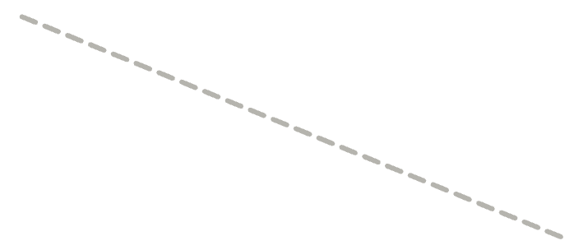
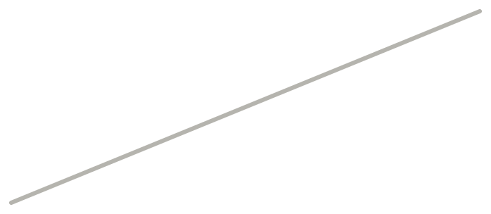
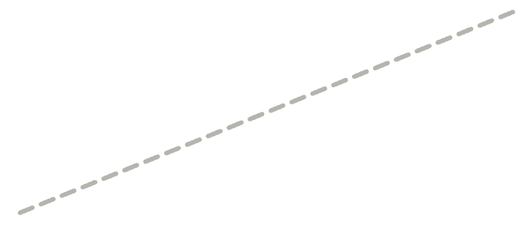
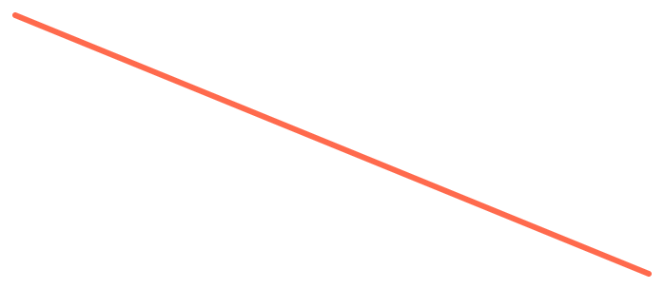


What a map can look like
EXERCISE · MAP YOUR DAY
Slack
Partner
Manager
S
A
ME
R
A
Barista
★ ChatGPT
Figma
Asked ChatGPT instead of my manager.
SOLID: TASK · DASHED: RELATIONAL · S R A: HOW IT FELT
26 / 34
Notes:
Here's a made-up example so you can see the grammar. The partner and the barista are relational, dashed lines: one where I shared how I felt, one that calmed me down. Slack and Figma are pure task. The manager is a task line where I asked for help. And the circled line: I asked ChatGPT something I would once have asked my manager. That's the line I want you to look for on your own map. Don't copy this layout; yours will be messier, and that's fine.

Slide 27
Put it on the wall
EXERCISE · SHARE IT
PAIRS · 3 MIN
THE WALL · 5 MIN
DEBRIEF · 5 MIN
Walk a neighbour through it
Dot the lines
Look at the circles
Green: a connection that helped.
Red: one that cost you something.
Where did a tool stand in for a person? Who would have noticed?
What surprised you about your own map?
You just did design research: observe first, then make sense of it.
DESIGN RESEARCH IN THE AGE OF AI
27 / 34
Notes:
Three minutes in pairs: walk your neighbour through your map, and tell them what surprised you. Then put the maps on the wall. Everyone gets green and red dots: green on a line that helped you, red on one that cost you something. Five minutes. Then we'll look at the wall together, especially the circled lines. Where did a tool stand in for a person? Who would have noticed? Point out what just happened: we observed first, and only then tried to make sense of it. That's lived experience turned into insight, which is the job. And look at the wall: green and red on the same lines. Both are true, just like on my map. Keep the wall up.

Slide 28
What would a platform know about you, and what would your map know?
TURN TO A NEIGHBOUR · 2 MIN
Two minutes with the same partner. Look at your map while you talk.
DESIGN RESEARCH IN THE AGE OF AI
28 / 34
Notes:
One more question with the same partner. Think about a platform you use every day. What does it know about you? Now look at your map. What does your map know that the platform doesn't? Take two or three answers. This is the gap between proxies and context.

Slide 29
Someone is measuring. Are we?
PART 3 · WHO’S MEASURING
IMPACTBENCH · AI NUTRITION LABEL · 2026
HARMS OF AI COMPANIONS · CHI 2025
Showed helpful behaviour
69%
Relational transgression
Verbal abuse and hate
Avoided harmful behaviour
53%
Self-inflicted harm
Harassment and violence
800+ metrics · 48,540 simulated conversations. Weakest area: supporting the user’s own agency.
Mis/disinformation
Privacy violations
From 35,390 Replika conversation excerpts
MIT MEDIA LAB ET AL., 2026 · ZHANG ET AL., 2025 · ALSO: PHARE V2, AILUMINATE
29 / 34
Notes:
And we're not starting from zero. Others are already measuring what AI does to people, and design research should be part of that. And right now, most of that work is happening in academia. Which is great, but it means it's not reaching the people building products. One area I'm really excited about is HCI evaluation for AI. Not measuring models by tokens and parameters, but against human metrics. Did it actually help? Did the person understand it? Did they come away better off? There's a team at MIT working on this; a friend of mine, Rachel, is on it. It's called ImpactBench, and the idea is to benchmark AI on its impact on people, not just its performance on tasks. That's exactly the kind of bridge I'm talking about. Background: Look at research through a humanity-centred lens. Researchers are already measuring what AI does to people. ImpactBench, an open benchmark launched in October 2026 by the MIT Media Lab with USC, UC Berkeley, and the Psychology of Technology Institute, publishes an "AI Nutrition Label" for models. It runs more than 800 metrics across 48,540 multi-turn conversations with simulated adult and teen users. Its headline finding: models showed helpful behaviour in 69% of evaluations but avoided harmful behaviour in only 53%, and supporting the user's own learning and agency was the most common weakness. At CHI 2025, Zhang and colleagues analysed 35,390 conversation excerpts that Replika users shared online and built a taxonomy of six harmful behaviours: relational transgression, verbal abuse and hate, self-inflicted harm, harassment and violence, mis/disinformation, and privacy violations. Two more for context: Giskard's Phare V2 benchmark (2025) found that better reasoning does not guarantee better safety, and MLCommons' AILuminate benchmark tests models across 12 hazard categories with more than 24,000 prompts. Someone is measuring. Design research should be contributing.

Slide 30
Research → what to do on Monday
PART 3 · BUILD BETTER
THE FINDING
SOURCE
DO THIS
More confidence in AI, less critical thinking
Lee et al., CHI 2025
Design for checking, not just confidence
Bonding with a chatbot tracks with loneliness
Fang et al., 2025
Measure wellbeing, not just engagement
Supporting users’ own agency is the weakest area
ImpactBench, 2026
Build in override, edit and undo
People need to know what it can do, and how well
Amershi et al., CHI 2019
Show confidence and limits up front
People treat computers as social actors
Nass et al., 1994
Match the personality to the capability
Direct manipulation gives people more control than chat
Shneiderman & Maes, 1997
Offer a menu of intents; keep chat for exploring
FULL CITATIONS IN THE REFERENCES
30 / 34
Notes:
So how does closing the gap help? Here's research that's already tackling these problems, and what you can do with it on Monday. Don't read all six. Pick two or three for this room. People who are more confident in AI think less critically about its output, so design for checking, not just for confidence. Bonding with a chatbot tracks with loneliness, so measure wellbeing, not just engagement. ImpactBench found models are weakest at supporting the user's own agency, so build in override, edit and undo. Amershi and colleagues' guidelines for human–AI interaction say to make clear what the system can do and how well, so show confidence and limits up front. We know people treat computers as social actors, so match the personality to what the product can actually do; that's the Clippy lesson. And direct manipulation gives people more control than open-ended chat, so offer a menu of intents for high-stakes tasks and keep chat for exploring. If you measure one new thing in a chat product: task success (did people get what they came for), repair rate (how often the conversation needs fixing), and trust calibration (do people trust it as much as it deserves, and no more). And treat prompts as interaction specs: version them, review them, test them. Before you give a system a face, four checks: does it serve the user's goal, is the mental model honest, can users opt out, and are the stakes high or low?

Slide 31

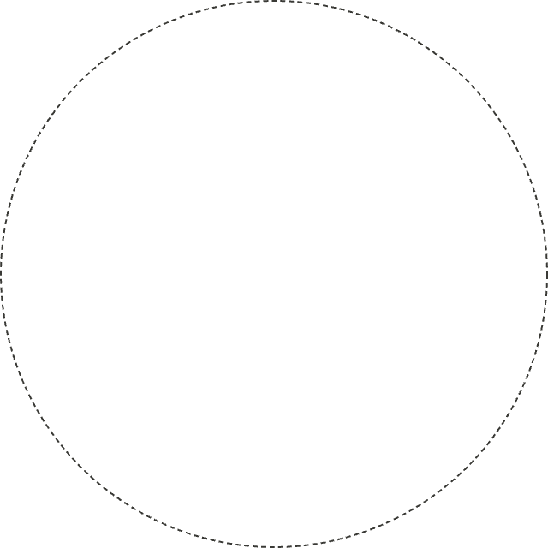


AI-centred vs. human-centred
PART 3 · WHAT DISTINGUISHES US
AI-CENTRED
HUMAN-CENTRED
AI
ME
What can the agent do?
Fit people around it.
What do people need?
Fit AI where it helps.
Our edge is a human-centred perspective.
NORMAN, 2023 · SHNEIDERMAN, 2022
31 / 34
Notes:
So what's our edge? Look back at the wall: every map started from a person in the centre, not from a tool. Keep that picture. What will distinguish us? Many people now look at problems through an AI-centred or agent-centred lens: start with what the agent can do, then fit people around it. Our value is the opposite starting point: start with what people need, value, and feel, then decide where AI belongs, if anywhere. Don Norman, who named user experience in 1993, now calls this humanity-centred design: working with people rather than for them, thinking in systems, and addressing root causes (Norman, 2023). Shneiderman makes the same case for AI: high automation and high human control can coexist.

Slide 32
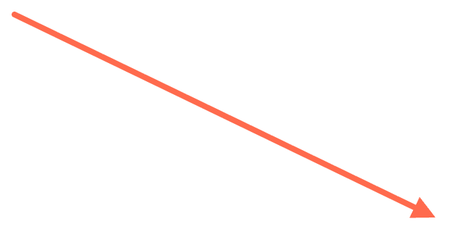

Craft matters more than ever
PART 3 · CRAFT
GENERATED
TRUST IN AI
TRUST IN YOURSELF
Fast · Cheap · Everywhere
Critical thinking
Critical thinking
CRAFTED
Conscious choices · Good information · Lived experience
More confidence in AI →
More self-confidence →
Craft is knowing you’re making choices, and making them with good information.
LEE ET AL., CHI 2025 · DIRECTION OF EFFECT, NOT DATA
32 / 34
Notes:
Craft looks different across different timelines. In the past, craft meant collecting flowers to make dye to paint with, or preparing sheepskin to make parchment, because we didn't have paper. Today it looks different. Crafting our designs isn't always about making difficult choices. It's about being conscious of the fact that we make a lot of choices when we design an experience. And we make good choices when we have good information. We get good information when we immerse ourselves in the process: when we engage with our own lived experience, and with other people's. That's the part a machine can't replace. It has never been easier to generate content fast: a brief, a screen, a prototype, a research summary. Generated content is fast, cheap, and everywhere. A 2025 Microsoft study of 319 knowledge workers (Lee et al., CHI 2025) found that the more confident people were in AI, the less critical thinking they did; the more confident they were in themselves, the more they did. Craft is how we keep that self-confidence earned, not borrowed.

Slide 33
Which line wins?
CLOSING · BACK TO THE MAP
Help in her
own language
MOM
★ ChatGPT
Emotional
reliance
My map still has both lines. Picture yours. What future do we want, and how do we get there?
ME
WHAT IT OPENS
Designer who
studies this
WHAT IT CAN COST
A creative
outlet
DAD
★ Suno
Designed to
keep you going
CIRCLES: PEOPLE · SQUARES: TOOLS · ★ AI
33 / 34
Notes:
So let's go back to where we started: my map. What have I learned? My mom's line and my dad's line still carry both colours. The door and the risk. Nothing about that changed tonight. What changed is how I'd study it: with questions that work, a map the person can see and correct, and a check on whether what we build actually helps. Now picture your own map from earlier. The green dots and the red dots, sometimes on the same line. We know we're going to keep building. So the question I'll leave you with is: which line do we want to win? What future do we want, and how do we get there? Thank you.

Slide 34
The research already exists
WHERE TO START
HUMAN–AI & WELLBEING
SAFETY & ALIGNMENT
BENCHMARKS
SOCIETY & HCI
COPHEE
CHAI
ImpactBench
HCII
NYU Tandon. Where I study, with Vedant Das Swain.
UC Berkeley. AI that is beneficial to people.
MIT Media Lab. AI’s effect on human wellbeing.
Carnegie Mellon. HCI research and design.
cophee-lab.com
humancompatible.ai
impactbench.media.mit.edu
hcii.cmu.edu
AHA
AI Security Institute
AILuminate
Data & Society
MIT Media Lab. Living with pervasive AI.
UK government. Tests frontier AI.
MLCommons. Open AI risk benchmark.
Independent. Social impact of data and automation.
aha.media.mit.edu
aisi.gov.uk
mlcommons.org
datasociety.net
HAI
HELM
Stanford. Human-centred AI research and policy.
Stanford CRFM. Holistic model evaluation.
hai.stanford.edu
crfm.stanford.edu/helm
NOT A COMPLETE LIST · A PLACE TO START
34 / 34
Notes:
The knowledge is out there. Here's where it's being made, and where you can go and find it. I want to leave you with doors, not just a call to action. Everything I've argued today says the knowledge we need already exists; here's where it's being made. On human–AI interaction and wellbeing: COPHEE at NYU Tandon, where I study with Vedant Das Swain; the Advancing Humans with AI programme at the MIT Media Lab; and Stanford's Institute for Human-Centered AI. On safety and alignment: the Center for Human-Compatible AI at Berkeley, and the UK's AI Security Institute, which tests frontier models. On benchmarks, the people actually measuring what AI does: ImpactBench from the MIT Media Lab, which looks at wellbeing; AILuminate from MLCommons, an open risk and reliability benchmark; and HELM from Stanford. And on society and HCI: Carnegie Mellon's Human-Computer Interaction Institute, and Data & Society. This isn't a complete list, and that's the point: the friction is finding and reaching these communities. Read their work, cite it, invite them in, and if you're in a company, partner with them. Leave this slide up during questions and into networking.

Slide 35
References 1/3
Abbott, A. (1988). The system of professions. University of Chicago Press.
MIT Media Lab, USC, UC Berkeley, & Psychology of Technology Institute. (2026). ImpactBench: Open benchmark of AI impact on humans.
Ahuja, S., Pemer, F., & Mastio, E. (2026). AI and identity work. Information and Organization, 36(3).
MLCommons. (2025). AILuminate safety benchmark.
Amershi, S., et al. (2019). Guidelines for human-AI interaction. CHI '19.
Nass, C., & Moon, Y. (2000). Machines and mindlessness. Journal of Social Issues, 56(1), 81–103.
Gabriel, I. (2020). Artificial intelligence, values, and alignment. Minds and Machines, 30, 411–437.
Nass, C., Steuer, J., & Tauber, E. R. (1994). Computers are social actors. CHI '94.
Giskard. (2025). Phare LLM benchmark V2: Reasoning models don't guarantee better security.
Norman, D. A. (1988). The psychology of everyday things. Basic Books.
Masson, D., Malacria, S., Casiez, G., & Vogel, D. (2024). DirectGPT. CHI '24.
Rahwan, I. (2018). Society-in-the-loop. Ethics and Information Technology, 20, 5–14.
ALSO: HER · MICO · GROK COMPANIONS · META AI STUDIO · CAC DRAFT RULES
APPENDIX
Notes:
References, part one. Leave the reference slides up during Q&A. Industry and policy sources: Microsoft's Copilot Fall Release introducing Mico (October 2025); xAI's Grok Companions (July 2025); Meta's AI Studio (July 2024); and the Cyberspace Administration of China's draft measures on anthropomorphic, emotionally interactive AI services (December 2025).

Slide 36
References 2/3
Reeken, T., Salous, M., & Abdenebaoui, L. (2025). Un-trusting the chat: Designing for calibrated trust in retrieval-augmented conversations. CUI '25.
Waytz, A., Cacioppo, J., & Epley, N. (2010). Who sees human? Perspectives on Psychological Science, 5(3), 219–232.
Reeves, B., & Nass, C. (1996). The media equation. CSLI / Cambridge University Press.
Weizenbaum, J. (1966). ELIZA. Communications of the ACM, 9(1), 36–45.
Robinson, R. B., et al. (2024). “That's not good science!”: An argument for the thoughtful use of formative situations in research through design. CHI EA '24.
Weizenbaum, J. (1976). Computer power and human reason. W. H. Freeman.
Zhang, R., Li, H., Meng, H., Zhan, J., Gan, H., & Lee, Y.-C. (2025). The dark side of AI companionship. CHI '25.
Shneiderman, B. (1983). Direct manipulation. IEEE Computer, 16(8), 57–69.
Zimmerman, J., Forlizzi, J., & Evenson, S. (2007). Research through design as a method for interaction design research in HCI. CHI '07.
Shneiderman, B. (2022). Human-centered AI. Oxford University Press.
Shneiderman, B., & Maes, P. (1997). Direct manipulation vs. interface agents. interactions, 4(6), 42–61.
DESIGN RESEARCH IN THE AGE OF AI
APPENDIX
Notes:
References, part two. Leave up during Q&A.

Slide 37
References 3/3
Akbulut, C., Weidinger, L., Manzini, A., Gabriel, I., & Rieser, V. (2024). All too human? Mapping and mitigating the risk from anthropomorphic AI. AIES '24.
Nielsen Norman Group. (2026). State of UX 2026.
Norman, D. A. (2023). Design for a better world: Meaningful, sustainable, humanity centered. MIT Press.
Candello, H., et al. (2025). The emerging use of GenAI for UX research in software development: Challenges and opportunities. arXiv:2512.15944.
Phang, J., et al. (2025). Investigating affective use and emotional well-being on ChatGPT. arXiv:2504.03888.
Fang, C. M., et al. (2025). How AI and human behaviors shape psychosocial effects of chatbot use: A longitudinal randomized controlled study. arXiv:2503.17473.
Rosala, M., & Moran, K. (2024). Synthetic users: If, when, and how to use AI-generated “research.” Nielsen Norman Group.
User Interviews. (2026). The state of user research 2026.
Federal Trade Commission. (2025, September 11). FTC launches inquiry into AI chatbots acting as companions [Press release].
Wen, J. (2026). The design process is dead. Here’s what’s replacing it. Lenny's Podcast.
Lee, H.-P., Sarkar, A., Tankelevitch, L., Drosos, I., Rintel, S., Banks, R., & Wilson, N. (2025). The impact of generative AI on critical thinking. CHI '25.
Ng, A. (2025, August). Interview. No Priors [Podcast].
DESIGN RESEARCH IN THE AGE OF AI
APPENDIX
Notes:
References, part three: the sources added for this version of the talk. Leave up during Q&A.

Slide 38
One pipeline, many tools
PART 1 · HOW WE WORK
DESIGN
PRODUCT
→
Figma Make · Lovable
→
ENGINEERING
AI-written brief
Code
RESEARCH
AI synthesis at scale, feeding every stage
Faster and wider. But is it rigorous?
DESIGN RESEARCH IN THE AGE OF AI
PARKED
Notes:
AI hasn't just changed users. It's changed how we work. Design tools and collaboration are changing. Companies are bringing AI in at the research stage to cut the time it takes to run studies and synthesise insights. Product managers hand designers AI-generated briefs, which then go into Figma Make or Lovable to produce initial flows. The problem is that different disciplines now work across different tools. Collaboration was easier when everyone was on the same platform. Now designers are increasingly expected to work in code environments that aren't native or intuitive to design practice. The shift has fundamentally changed how teams collaborate. And researchers use the same tools to transcribe and synthesise insights at a scale that wasn't possible before, which has its own implications for rigour.

Slide 39
Team norms are being rewritten
PART 1 · HOW WE WORK
THE WRITER
THE ENGINEER
Told to use AI.
Judged for using it.
Expected to use AI.
Others clean up after.
AI is redrawing who owns which work.
Who owns the prompt? Who signs off? What counts as done?
ABBOTT, 1988 · RAHWAN, 2018 · AHUJA ET AL., 2026
PARKED
Notes:
Designers adopting new tools at different rates is a symptom of a much larger problem: people don't adopt new software or workflows at the same pace, and they have fundamentally different preferences for how they work. From a design perspective, differential adoption creates friction within teams. From a research perspective, drawing on Abbott's theory of professional jurisdictions (1988), it's also a boundary problem: AI is redrawing the lines of who legitimately owns what kind of work, and the social norms haven't caught up. The problem isn't unique to design. A manager might pressure a writer to use AI even as peers judge the writer for doing so. Software engineers largely escape that pressure; using AI to write code is socially acceptable, even expected. The trouble arises when AI-generated code is low quality and becomes someone else's problem. The social contracts around AI use vary enormously by discipline and context (Rahwan, 2018). Recent empirical work shows AI fragmenting professional identity: in a study of patent attorneys, Ahuja, Pemer, and Mastio (2026) found that people's responses depended on how they saw themselves as individuals, as members of their organisation, and as professionals. Working culture is where the shift becomes visible. Teams now have to decide who owns the prompt, who signs off on AI output, and what "done" means. We don't yet understand how the integration of AI into work culture is reshaping social dynamics, or its true impact on the social fabric at large. Answering that question will require rigorous study. Four rules teams can take from this: protect deep research, using AI for synthesis and people for interpretation; set norms for disclosure, review and accountability; treat AI output as hypotheses, not conclusions; and fix the system, not the person, when adoption is uneven.

Slide 40
What in your workflow or team changed this year?
TURN TO A NEIGHBOUR · 2 MIN
Two minutes in pairs. Then one answer each, shared with the room.
DESIGN RESEARCH IN THE AGE OF AI
PARKED
Notes:
Pause for two minutes. This is the working-culture check: tools, handoffs, who owns what, and what "done" means now. Take two or three answers. If time is short, take one and move on.

Slide 41
The research exists. The bridges don’t.
PART 2 · THE GAP
ACADEMIA
INDUSTRY
TRANSLATORS
Knows a lot
Ships fast
Very few
Publishes in papers and venues industry rarely reads. Takes years.
Works in weeks. Keeps its data and findings inside the company.
The people who turn findings into decisions someone can act on.
Silos on both sides, and almost no one in between.
DESIGN RESEARCH IN THE AGE OF AI
PARKED
Notes:
So why don't we know about it? I think it's because the gap between academia and industry is wide. Academia knows a lot. But it publishes in papers and conferences that people in industry rarely read, and it moves on a timescale of years. Industry moves in weeks, and what it learns mostly stays inside the company, in proprietary data. Both sides are silos. And in between, there are very few translators: people whose job is to take a finding and turn it into something a designer or a product team can act on. The knowledge exists. The bridges don't. This has happened before. Let me show you how Europe solved it.

Slide 42
A copy of a copy
PART 2 · THE RESULT
ACCESS
Design has never been more accessible.
INVESTMENT
We have never invested more in design.
OUTPUT
Yet so much of what we make feels like a copy of a copy.
Every copy loses a bit of the reason.
DESIGN RESEARCH IN THE AGE OF AI
PARKED
Notes:
And you can see the result in the products. How many "Airbnb for X" apps have we seen? How many "Uber for X"? And now, honestly, how many products are basically ChatGPT with a different UI on top? It's a copy of a copy of a copy. Every time you copy something, you lose a bit of the reason it was designed that way in the first place. So the question I keep coming back to is: do we actually have the skills to know what the problems are? Not to build the thing. To know what's worth building. Because here's the paradox. It has never been easier to build. You can go from an idea to a working prototype in an afternoon. And yet it feels like we're further than ever from genuinely new things. The bottleneck moved. It's not making anymore. It's understanding. Background: Andrew Ng said in 2025 that a prototype now takes a day, so waiting a week for user feedback is painful, and that the bottleneck is deciding what to build. Jenny Wen, who leads design for Claude, argues the linear design process is dead and that intuition should drive decisions when research is thin. I'd put it differently: the build step shrank, so observing and testing became a bigger share of the work, and intuition is built from observation. And researchers feel it: in User Interviews' 2026 survey, 80% use AI in their work, and 63% worry it is eroding critical thinking. So the question isn't how to build faster. It's how to understand better, and that starts with trust.

Slide 43
▶ PLAY CLIP
Her (2013)
30–60 seconds · [replace with a film still or the clip]
DESIGN RESEARCH IN THE AGE OF AI
PARKED
Notes:
Cold open. Play 30 to 60 seconds of Her (Spike Jonze, 2013). Don't talk over the clip; let it land before you say anything.

Slide 44
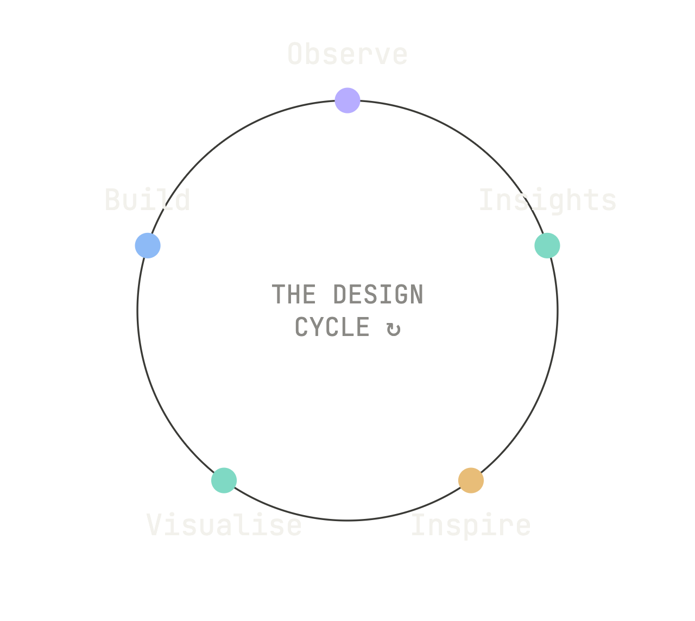
Observation, not prediction
PART 3 · WHAT AI CHANGED
Her didn't predict the future. It gave language to the present.
Design research can do the same.
DESIGN RESEARCH IN THE AGE OF AI
PARKED
Notes:
Her, by Spike Jonze, came out in 2013. Thirteen years ago. And if you watch it today, it doesn't really feel like science fiction anymore. It feels more like a documentary. I don't think that's because Spike Jonze predicted the future. I think he observed the present. He looked at how lonely people were, how much we were already talking to our devices, and he translated that into a story. That's observation, not prediction. That's what a good researcher does, right? The job of UX research is to translate lived experience into insight. It's the same cycle: observe, find the insight, make something from it, and look again. And here's the uncomfortable part, the Black Mirror effect. A lot of products today look like they were built straight out of dystopian sci-fi. The film was the warning, and somebody read it as a spec. Part of the reason is marketing: if everyone already knows the story, it's cheaper to sell.

Slide 45





What makes people trust AI?
PART 3 · WHAT AI CHANGED
← CLOSER · FASTER TO SHIP
FURTHER · SLOWER →
THE PROBLEM
DESIGN
AGENCY
TECHNICAL
INSTITUTIONAL
People don’t trust AI
How it feels
What people can do
What the model does
Who answers for it
Forms that feel trustworthy
Override, edit, undo
Fewer hallucinations
Liability and recourse
Emotional bonds
Ways to verify answers
Explainability
Audits and regulation
Friendly personas
Consistent answers
Recovery from errors
Honest data practices
Alignment
Incentives beyond engagement
DESIGN CANNOT BE THE CHEAP CO-OUT TO ACTUALLY SOLVING TRUST ISSUES
DESIGN RESEARCH IN THE AGE OF AI
PARKED
Notes:
But feeling trustworthy and being trustworthy are two different things. The easy fixes are the avatar, the voice, the tone. The hard fixes are explainability, transparency, alignment: actually being able to say why the system did what it did, and making sure it does what we meant. Background: So the problem is that people don't trust AI. How do we fix that? There are four kinds of fix, and they sit at different distances. Design is closest: forms that feel trustworthy, emotional bonds, friendly personas. They're quick to ship. Agency is next: letting people override, edit and undo, giving them ways to verify an answer rather than just an explanation of it, and recovering gracefully when the system gets it wrong. Trust is built in the failure modes, not the successes. Technical fixes are further out: fewer hallucinations, real explainability, consistent answers, alignment. They're hard and slow. Furthest out are institutional fixes: who is liable when it goes wrong, independent audits and regulation, honest data practices, and business models that aren't built on engagement. If the incentive is engagement, no interface will earn trust. Two things to add. Trust isn't one thing: people will trust AI with a birthday poem long before a diagnosis, so it depends on the stakes. And the goal isn't more trust; it's calibrated trust, trusting it as much as it deserves and no more. That's the risk on this slide: design fixes are closer and faster, so we can make AI feel trustworthy long before it is, and use design to paper over what's missing further out. That's where the next observation comes in.

Slide 46
Two ways to build trust
PART 3 · TRUST
THE WRONG WAY
THE RIGHT WAY
Make it feel trustworthy
Make it trustworthy
A face, a voice, a persona
Show what it can do, and how well
Borrowed familiarity, like Samantha’s voice
Let people check, override and undo
Optimise for engagement
Recover gracefully from errors
Hide the limits
Measure wellbeing, not just engagement
The goal is calibrated trust: as much as it deserves, and no more.
DESIGN RESEARCH IN THE AGE OF AI
PARKED
Notes:
So there are two ways to build trust. The wrong way is to make AI feel trustworthy: give it a face, a voice, a persona. Borrow familiarity, like Samantha's voice. Optimise for engagement, and keep the limits out of sight. It's fast and cheap to ship, and we saw what it costs: more bonding, more loneliness. The right way is to make it trustworthy: show people what it can do and how well, let them check, override and undo, recover gracefully when it gets things wrong, and measure whether people are actually better off, not just whether they come back. The goal isn't more trust. It's calibrated trust: trusting it as much as it deserves, and no more. And you can't calibrate trust without understanding people, which brings us to craft.

Slide 47
Big data vs thick data
PART 3 · CRAFT AND EMPATHY
BIG DATA
THICK DATA
ANSWERS
What happened? How many?
Why? What did it feel like?
COMES FROM
Logs, clicks, transcripts at scale
Observing, listening, being there
AI
Very good at it
Can’t gather it for you
GIVES YOU
Patterns
Meaning
AI scales the what. Empathy finds the why.
WANG, 2013 · AFTER GEERTZ, 1973
PARKED
Notes:
To build trust the right way, you have to understand people. And AI can't observe. It wasn't in the room. It works from what's already been written down: signals of signals. Here's the difference I think matters most for us. Big data tells you what happened, and how many times: logs, clicks, thousands of transcripts. AI is very good at that, and it's getting better. Thick data tells you why: the context, what it felt like, what it meant to the person. You only get it by observing, listening, being there. The ethnographer Tricia Wang called it thick data, borrowing from the anthropologist Clifford Geertz's idea of thick description. More data isn't the same as feeling heard. Feeling heard takes trust, and trust takes people. That's why craft and empathy aren't soft skills here. They're how you get the data AI can't. And it's exactly what you'll do in a few minutes when you map your own day. That's the role of UX research: to translate lived experience into insight.

Slide 48
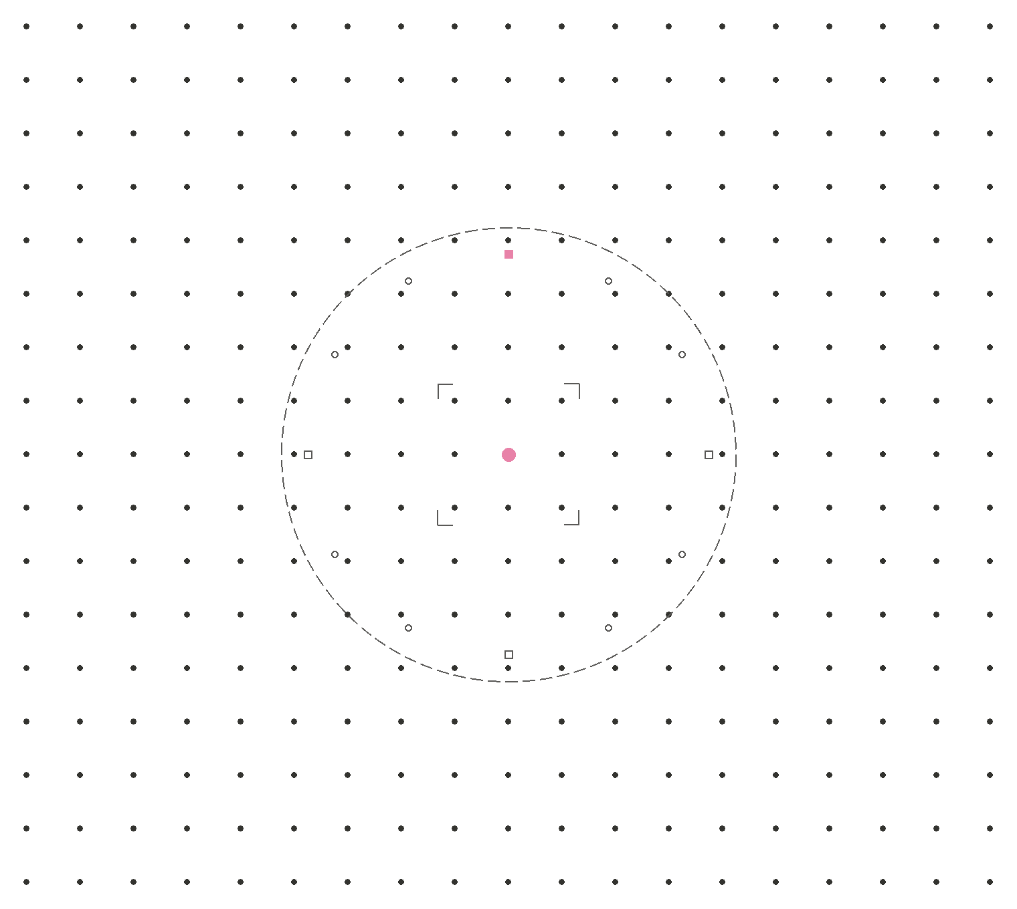
Build
bridges
DESIGN · AI · RESEARCH
Part 4 · Research you can use, and the map we need
By Issac Ting (2026)
7:40–7:55 PM
Notes:
Part four: build bridges. The research exists. Here's how to use it, and what's missing. Timing: aim to be here by 7:40, and at questions by 7:55.

Slide 49
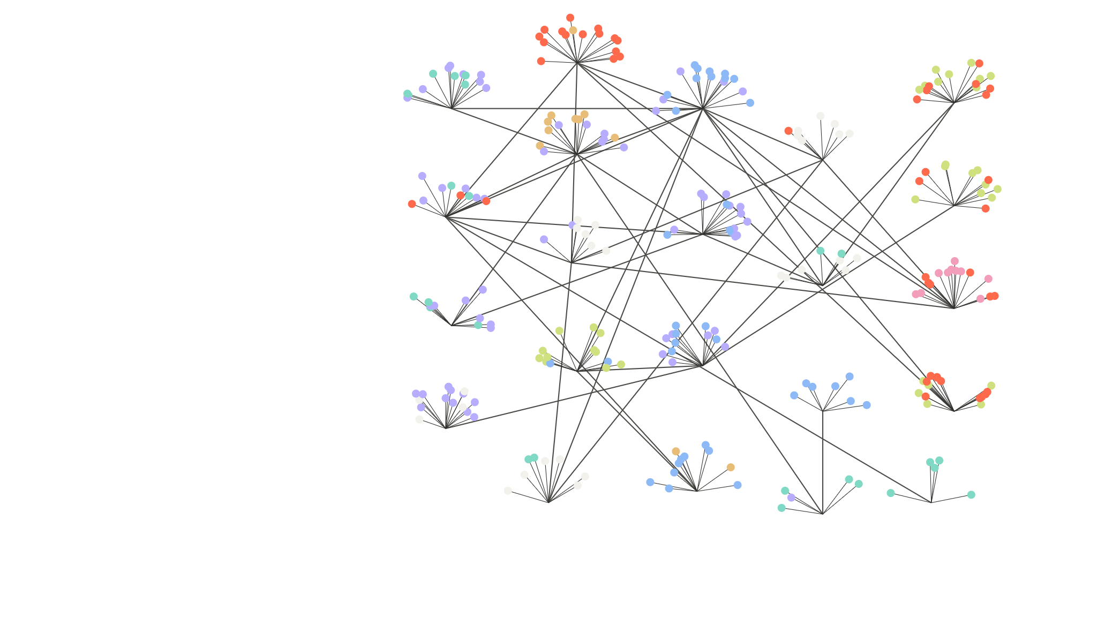
Today’s cast
22
PART 4 · THE NETWORK TODAY
UN · UNESCO
1
9
14
MIT Media Lab
Google
NIST
6
11
GENERATE KNOWLEDGE
ACM CHI
AI Now Institute
BUILD TECHNOLOGY
15
2
TRANSLATE & EDUCATE
10
UK AISI
SHARE & CONVENE
Stanford HAI
8
Microsoft Research
MEASURE & STANDARDISE
Data & Society
13
SET POLICY
Algorithmic Justice League
16
ENFORCE LAW
3
EU AI Office
CRITIQUE & ADVOCATE
CMU HCII
12
7
Colour = role. Each dot is a person doing that kind of work. Plenty of makers, builders and rule-setters. Very little teal: the translators.
MLCommons
Anthropic
19
17
4
Figma
Singapore IMDA
Berkeley CHAI
5
18
20
Hugging Face
21
Center for Humane Tech
NN/g
IDEO
LINES: RESEARCH, FUNDING, PUBLISHING AND TESTING TIES, SIMPLIFIED
PARKED
Notes:
Here's the knowledge map today: the same roles as the Renaissance map, same colours. The knowledge we need exists. The problem is where it lives. A lot of it is locked away in academic papers nobody in industry reads. A lot of it is locked away in proprietary data that never leaves the company. So the network today looks something like this. Lots of nodes. Not a lot of lines between them. And compare it with the Renaissance map: very few translators. Background: Here's today's network, coloured by what each actor does, not what sector it's in. Purple generates knowledge: the MIT Media Lab, Stanford HAI, Carnegie Mellon's HCI Institute, Berkeley's Center for Human-Compatible AI, and Microsoft Research. Blue builds technology: Google, Anthropic, Hugging Face, Figma. Some of them also do serious research, which is why you see purple dots around them. Amber shares and convenes: ACM CHI, where the field publishes. Lime measures and sets standards: MLCommons, NIST, and the UK's AI Security Institute, which tests frontier models. Coral sets policy: Singapore's IMDA and the UN, with UNESCO's 2021 ethics recommendation and, in 2025, a new scientific panel and global dialogue on AI. Pink enforces law: the EU AI Office, which implements the AI Act. White critiques and advocates, and I've deliberately given them room: Data & Society; the AI Now Institute, on the power and accountability of AI companies; the Algorithmic Justice League, whose Gender Shades study exposed bias in commercial facial recognition; and the Center for Humane Technology, founded by former Google design ethicist Tristan Harris, which asks designers to look at what attention-driven products do to people. Others play this role too: DAIR, the Ada Lovelace Institute, the Electronic Frontier Foundation. And teal translates and educates: the people who carry research into practice, like NN/g and IDEO. Look how little teal there is. Compare it with the Renaissance network. We have finders, keepers, patrons and rule-makers. What's thin is the translators. That's the role design research can play. These roles and links are simplified and illustrative, not a complete map.

Slide 50
Two ends of the same pipe
PART 4 · WHAT WE NEED
UPSTREAM · TRANSLATORS
MIDDLE · BUILD
DOWNSTREAM · VALIDATION
Make sense of what we observe
→
AI closed this gap
→
Check what happens after we ship
Turn research and observation into something we can build on. What Don Norman did for UX.
Design to code, in an afternoon.
Consequences, not just conversion. Measured against people, not tokens.
AI closed the middle. The two ends are on us.
DESIGN RESEARCH IN THE AGE OF AI
PARKED
Notes:
So what do we need? More bridges. I think of it as two ends of the same pipe. On one end, we need translators. People like Don Norman, who could take research about how people think and turn it into something a designer could actually use. We had those people. We need a lot more of them now. In the middle is building, and AI has more or less closed that gap. On the other end, we need downstream validation. Actually checking what happens after we ship. Understanding the consequences, not just the conversion rate. And for that we need better tools. This is where the opportunity is. People on the ground who observe what's actually happening; translators who turn research into decisions; and better metrics and tools to check what happens after we ship. One of the biggest challenges right now is exactly that: how do we build interfaces that are trustworthy, not just ones that feel trustworthy?

Slide 51



Three moves
PART 4 · THE PATH FORWARD
LOOK BACK
TODAY
LOOK FORWARD
RECONNECT
REDEFINE
LEAN INTO CRAFT
Find the lines
Be the translator
Keep the rigour
Read the research. Talk to academics. The value is in the lines between the nodes.
Observation and judgement: the part that can’t be automated, and the part we let slip.
AI can make the screen. Observe, make sense of it, check what happens after.
Go back to go forward.
DESIGN RESEARCH IN THE AGE OF AI
PARKED
Notes:
So if you're a designer or a researcher, here's what I'd take away. Three moves. One, reconnect. Go read the research. Talk to the academics. Find the lines between the nodes, because that's where the value is. Two, redefine. Your job isn't to make the screen. AI can make the screen. Your job is to be the translator: to observe, to make sense of it, and to check what happens after. And three, lean into craft. The observation, the judgement, the rigour. That's the part that can't be automated, and that's the part we let slip.

Slide 52
Somebody has to
go find it.
CLOSING · POGGIO, AGAIN
Poggio didn’t write the book. He knew it mattered, and made sure it was copied, translated and passed on. That’s the job.
DESIGN RESEARCH IN THE AGE OF AI
PARKED
Notes:
I'll leave you with Poggio. Six hundred years ago, he walked into a monastery library and found a book that had sat there, more or less unread, for centuries: Lucretius. He didn't write it. He just knew it mattered, and he made sure it got copied, translated, and passed on. That's the job. The knowledge is out there. Somebody has to go find it. And think back to my map at the start: my mom, my dad, and two lines on each. Somebody has to go and find out which line wins, for whom, and when. That's what I'm trying to do, and I hope some of you will too. If you want the longer version of this argument, where the translators went and how we check what we ship, that's my other talk: Where did all the translators go? Thank you. I'll leave the next slide up while we head into networking.

Slide 53
Three questions
THE PLAN
01
Look back
How knowledge travels: the Renaissance, and UX
02
What AI changed
Trust, and how we work now
03
What we need
Build better. Then: map your day
DESIGN RESEARCH IN THE AGE OF AI
PARKED
Notes:
Here's the plan, in three parts. First, we look back: how Europe found its lost knowledge in the Renaissance, and how UX got its knowledge in the first place. Second, what AI changed: why so much of it comes down to trust, and how it's changing the way we work. Third, what we need now: the part of the work AI can't do, and how to build better AI products. Then you'll map your own day, and we'll talk about it. Timing: Part 1 by 6:40, Part 2 by 6:55, Part 3 by 7:15, the exercise by 7:35, close by 7:55.

Slide 54
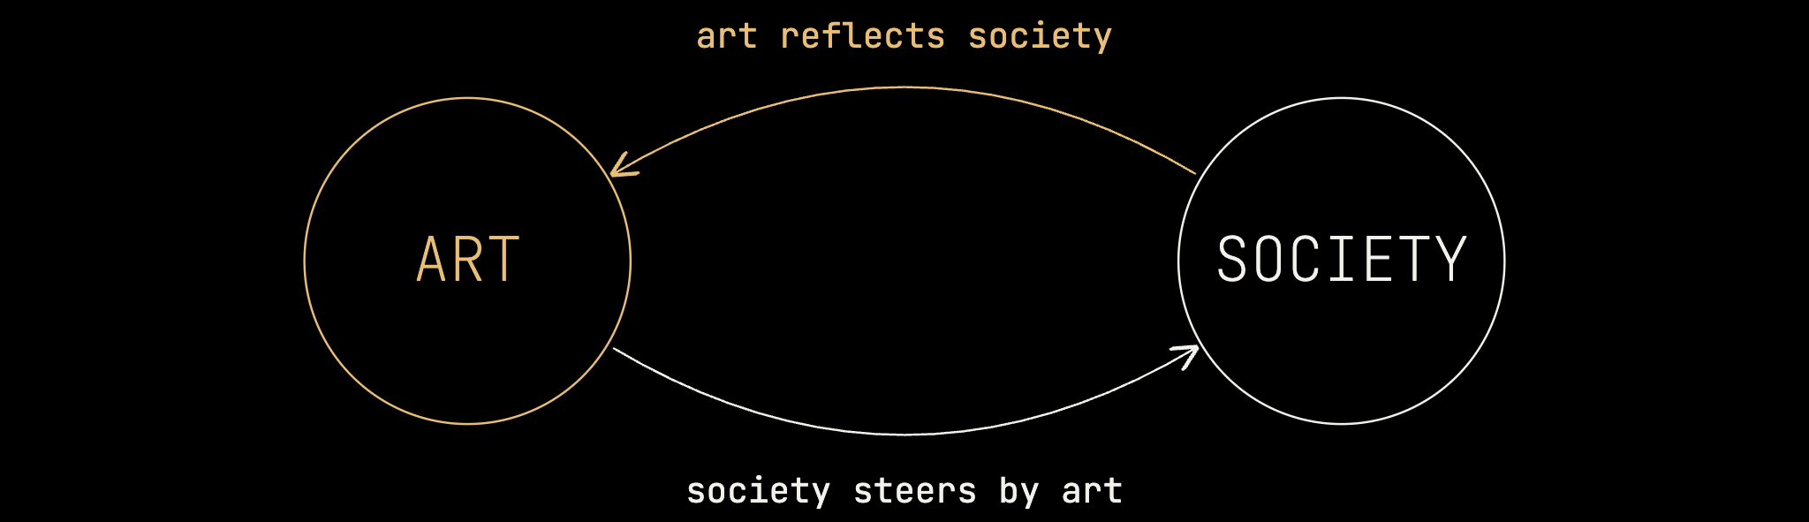
The Black Mirror effect
PART 2 · ART ↔ SOCIETY
Why do we keep building things that writers try to warn us from?
DESIGN RESEARCH IN THE AGE OF AI
PARKED
Notes:
Now here's the part that worries me. A lot of products today look like they were built straight out of dystopian sci-fi. The film was the warning, and somebody read it as a spec. I call it the Black Mirror effect. We watch the cautionary tale, and then we go and build the thing anyway. And part of the reason, honestly, is marketing. If everyone already knows the story, it's a lot cheaper to sell. You don't have to explain the product. The movie already did that for you.

Slide 55
Four rules for AI-era teams
PART 2 · HOW WE WORK
Protect deep research
Set team norms
AI for synthesis at scale. People for interpretation and immersion.
Disclosure, review, accountability, skill development.
Hypotheses, not conclusions
Fix the system, not the person
Use AI to find edge cases and questions, not answers.
Uneven adoption is a systems problem, not a personal failing.
DESIGN RESEARCH IN THE AGE OF AI
PARKED
Notes:
Keep this tight; it's a list, not an argument. Protect deep research: use AI for synthesis at scale, and keep people on interpretation and immersion in context. Set team norms for disclosure, review, accountability, and skill development. Use AI to generate hypotheses and find edge cases, not to draw conclusions. And treat differential adoption as a systems problem, not a personal failing.

Slide 56
PART 3 · HOW TO BUILD A PRODUCT
With AI, it is much easier to close the gap
between visualisation and building.
RESEARCH
DESIGN
ENGINEER
01
02
03
04
05
06
OBSERVE
STRUCTURE
ABSTRACTION
REFINEMENT
BUILD
TEST
But it is much harder for us to observe
and derive insights.
And it is harder
to test products.
DESIGN RESEARCH IN THE AGE OF AI
PARKED
Notes:
Building a product maps onto the same steps: research, design, engineering. Now what AI has done, and it's genuinely impressive, is close the gap in the middle. Design to code is basically solved, or close to it. AI is a really good translator from one abstraction to another.

Slide 57
Calibrate trust, not dependency
PART 3 · BUILD BETTER
BEFORE YOU GIVE IT A FACE
01
02
Emotional design is not a substitute for interaction design.
Does it serve the user's goal?
Is the mental model honest?
People differ: anthropomorphism is a stable trait, not a universal response.
03
04
Can users opt out?
High stakes or low?
WAYTZ, CACIOPPO & EPLEY, 2010
PARKED
Notes:
So how do we build better? Start with trust, since that's where Part 2 left us. Before you give a system a face, run four checks: does the relationship serve the user's goal; is the mental model it creates honest; can users opt out; and are the stakes high or low? Two principles follow. Don't let emotional design substitute for interaction design. And design for trust calibration, not emotional dependency. Remember that individual differences matter: research on the Individual Differences in Anthropomorphism Questionnaire shows that the tendency to see minds in machines is a stable disposition that varies between people (Waytz, Cacioppo & Epley, 2010). A face that reassures one user can mislead another. Practitioners need to hear this slide.

Slide 58
Measure what chat actually does
PART 3 · BUILD BETTER
TASK SUCCESS
REPAIR RATE
TRUST CALIBRATION
Did people get what they came for?
How often does the conversation need fixing?
Do people trust it as much as it deserves, and no more?
Prompts are interaction specs. Version them, review them, test them.
DESIGN RESEARCH IN THE AGE OF AI
PARKED
Notes:
So what do we measure? Click-through, completion rates and funnel drop-off were built for fixed flows. They're not enough for a conversation. Three measures do more work. Task success: did people get what they came for? Repair rate: how often does the conversation go wrong and need fixing? And trust calibration: do people trust the system as much as it deserves, and no more? That last one ties straight back to the trust slides. And one shift in practice: if the conversation is the interface, the prompt is the interaction spec. Treat it like one: version it, review it, test it.

Slide 59
It took a whole cast
PART 1 · HOW THE CLASSICS CAME BACK
FIND
Where is the knowledge?
TRANSLATE
Can we read it?
APPLY
What do we build with it?
HUNTERS
TEACHERS
PATRONS
Poggio Bracciolini searches monastery libraries and recovers Lucretius, Quintilian and Vitruvius (1415–17).
Manuel Chrysoloras teaches Greek in Florence from 1397, training the first generation of readers.
Cosimo de’ Medici funds Ficino’s Plato.
PRINTERS
TRANSLATORS
Aldus Manutius prints 30 first editions of Greek texts, in pocket-size books (from 1494).
KEEPERS
Gerard of Cremona renders 87 works from Arabic in Toledo. Ficino puts all of Plato into Latin (1484).
Byzantine and Islamic scholars kept the texts alive. Bessarion gives 746 manuscripts to Venice (1468).
PRACTITIONERS
Alberti turns Vitruvius and Roman ruins into the first Renaissance treatise on architecture (1452).
FIND → TRANSLATE → APPLY
PARKED
Notes:
Now, I think one of the most important things is to look at the network of people that made it happen. You had the people who stored knowledge, and for a long time they were very isolated: monks in monasteries. You had Islamic scholars who literally didn't speak the same language, so you needed translators, often people who grew up under Muslim rule. Greek went into Arabic, and then Arabic went into Latin, in places like Toledo. Then you had educators, like Chrysoloras, who came from Constantinople to teach Greek in Florence. And you had critics and curators: people who checked whether things were true, and chose what was worth keeping. Background: The Renaissance didn't happen because one genius found an old book. It took a whole cast of people, and it's worth naming the roles, because we need the same roles today. First, finding. Someone had to know where the knowledge was. Poggio Bracciolini was a papal secretary who spent 1415 to 1417 searching monastery libraries in Switzerland and Germany; he recovered Lucretius' On the Nature of Things, Quintilian, and Vitruvius on architecture. And someone had to have kept those texts in the first place: Byzantine and Islamic scholars, and medieval monasteries. After Constantinople fell in 1453, Cardinal Bessarion gave his library, 746 manuscripts, most of them Greek, to Venice in 1468, so they wouldn't be lost. Second, translating. Most Italians couldn't read Greek. In 1397 Florence's chancellor, Coluccio Salutati, brought in Manuel Chrysoloras from Constantinople to teach it, and his students became the next generation of scholars. Translators did the rest: in the 12th century Gerard of Cremona translated 87 works from Arabic in Toledo, including Ptolemy's Almagest; in the 15th, Marsilio Ficino translated all of Plato into Latin, published in 1484. Third, spreading and applying. Someone paid: Cosimo de' Medici funded Ficino's work. Someone distributed it: from 1494 Aldus Manutius in Venice printed 30 first editions of Greek texts, in small, portable books. And someone used it: Leon Battista Alberti took Vitruvius and his own study of Roman ruins and wrote De re aedificatoria in 1452, the first architectural treatise of the Renaissance. Map that onto today. Hunters and keepers are the researchers and institutions who know where knowledge lives: universities, labs, archives. Teachers and translators are the people who turn papers into practice; that's a role design research can play. Patrons are the companies and funders who pay for it. Printers are the platforms and open access that spread it. Practitioners are us, the people who build. Right now, we have plenty of practitioners and very few translators.

Slide 60
PART 3 · HOW TO BUILD A MODEL
COLLECT DATA
CREATE MODEL
DEPLOY MODEL
01
02
03
04
05
06
OBSERVE
STRUCTURE
ABSTRACTION
REFINEMENT
BUILD
TEST
Building an AI model follows the same broad process as creating human knowledge.
DESIGN RESEARCH IN THE AGE OF AI
PARKED
Notes:
Let me zoom out and talk about how you actually build a model of the world. Any model: a design, a product, a mental model, an AI model. It starts with observation. You watch people, you notice things. Those observations become signals. The signals get structured and abstracted into something you can work with. Then that gets refined, built, and tested.

Slide 61
What part of your craft would you refuse to hand off?
TURN TO A NEIGHBOUR · 2 MIN
Two minutes in pairs. Then one answer each, shared with the room.
DESIGN RESEARCH IN THE AGE OF AI
PARKED
Notes:
Pause for two minutes. This sets up the closing. People will name observing, listening, and judging; those are the parts of the craft worth protecting. Take two or three answers, then close.

Slide 62


The answer is not more AI
PART 3 · TAP INTO OTHER SCIENCES
↑ HUMAN CONTROL
Too much human control
Reliable, safe, trustworthy
SHNEIDERMAN, 2022
High automation and high human control.
GABRIEL, 2020
Alignment is normative, not only technical.
Low on both
Too much automation
THE GAP
We don't share a language yet.
COMPUTER AUTOMATION →
SHNEIDERMAN, 2020, 2022 · GABRIEL, 2020
MOVED TO TALK 2
Notes:
The way to update our methods isn't more AI. It's re-engaging with the fields that built the rigour: HCI, AI safety, and alignment. Shneiderman's Human-Centered AI (2022) rejects the idea that more automation must mean less human control; it argues for designs that achieve high levels of both. Gabriel (2020) argues that value alignment is normative as well as technical, and that it requires stakeholder deliberation, which is exactly what design research supports. The problem is that we don't yet share a language with these fields. This is a bridge, not a surrender: design has something to contribute.

Slide 63
PART 2 · THE UX KNOWLEDGE PROBLEM
UX inherited HCI's methods.
Not how to make new knowledge.
DESIGN RESEARCH IN THE AGE OF AI
PARKED
Notes:
So those are three observations shaping the conversation right now. But here's what I think matters most: many of these changes are not new. The research already exists. So why does it feel like we're starting from scratch? UX is a young field. Don Norman's job title at Apple put "user experience" into the vocabulary in 1993, and for much of the time since, UX sat inside HCI. HCI itself drew together psychology, the social sciences, engineering, and computer science: people from those disciplines who agreed that this subject needed its own study. They brought the rigour of their home disciplines and used it to build a new field. When UX emerged from HCI, it adopted the techniques and methods, but not the discipline and rigour needed to create new knowledge, share it, and retain it within the community. Bootcamps taught specific UX methods focused on usability and heuristics. They worked well: they produced a new generation of designers at a moment when we badly needed them, particularly during COVID. But they left a vacuum. We adopted the knowledge without acquiring the skills to generate new knowledge.

Slide 64


Close the loop
PART 3 · THE DESIGN RESEARCH CYCLE
01
02
03
04
05
06
OBSERVE
STRUCTURE
ABSTRACTION
REFINEMENT
BUILD
TEST
Notice something in the world
Check the literature and the lineage
Find precedents and patterns
Define the outcome and the trade-offs
Make the smallest thing that tests it
Evaluate against what you defined
What we build goes into the wild.
We need to continue observing it to understand it's impact.
DESIGN RESEARCH IN THE AGE OF AI
PARKED
Notes:
These are the same six steps from part two, closed into a loop. That's the design research cycle. One, observe: notice something in the world. Two, structure: check the literature, and draw on the lineage of psychology, HCI, social science and design. Three, abstraction: find precedents and patterns; ELIZA and CASA tell us we've been here before. Four, refinement: define the outcome you want, trust, accessibility, deeper bonds, and surface what you're trading off. Five, build the smallest thing that tests it. Six, test it against what you defined: metrics, harms, success criteria. Then the step that closes the loop, and the one UX skipped: name it and share it. Document it, publish it, keep it, so the next person starts further ahead. The cycle draws on de Groot's empirical cycle, Lewin's action research, research through design (Frayling; Zimmerman and colleagues), Schön's reflective practice, and Peirce's abduction. Notice that the two coral steps, observe and test, are exactly the two the problem gap says we're running out of. You just did step one on your maps.

Slide 65
Things are not the same
PART 1 · WHAT AI CHANGED
In recent times, it is hard to deny that creating and designing software has changed significantly.
As designers, it feels like we are being pulled in different directions.
Some people are saying “UX” is dead; others claim that “taste” will be the next moat.
In this workshop, instead of leaning into current trends, we will examine, think through, and discuss the implications of these changes.
Hopefully, using those methods, we will be able to decide for ourselves what these changes mean for us.
DESIGN RESEARCH IN THE AGE OF AI
PARKED
Notes:
Before we start: it's hard to deny that making software has changed a lot. As designers, we're being pulled in different directions. Some people say UX is dead; others say taste is the next moat. In this workshop, instead of leaning into the latest trend, we'll examine these changes, think them through, and discuss what they mean, so that each of us can decide for ourselves what they mean for our work.

Slide 66

Focusing on a few observations
PART 1 · WHAT AI CHANGED
Recent developments in AI have caused ripples in many industries, fields, and the world we live in.
Our goal today is to look at a few of these ripples, observe them, understand them, and make sense of what we can do about them.
DESIGN RESEARCH IN THE AGE OF AI
PARKED
Notes:
Recent developments in AI have caused ripples across industries, fields, and the world we live in. Our goal today is to look at a few of those ripples: observe them, understand them, and work out what we can do about them. I'll start with a film.

Slide 67
Trust was the point
PART 1 · WHY SAMANTHA'S VOICE?
Altman's pitch: her voice could help people feel comfortable with AI.
THE PROBLEM
THE FIX
People don’t trust AI
Using a “familiar” voice to create trust
JOHANSSON, PUBLIC STATEMENT, MAY 2024
PARKED
Notes:
Her had real cultural weight. Sam Altman himself tried to get Scarlett Johansson to voice ChatGPT. According to Johansson's statement in May 2024, he told her that her voice could help consumers feel comfortable with the shift that AI brings, and that it would be comforting to people. In other words, a familiar voice would help usher in the age of AI by easing the fear that still lingers around it. Trust is a big factor in this whole conversation, and it's the thread that connects the next few slides.

Slide 68
The problem gap
PART 2 · WHAT IT MEANS FOR DESIGNERS
As building software becomes easy, the gap that widens is in how we derive new knowledge, and how we check that what we build is working.
DESIGN RESEARCH IN THE AGE OF AI
PARKED
Notes:
Here's what this means for designers. As building software becomes easy, the gap that widens is in how we derive new knowledge and how we check that what we build actually works.

Slide 69
None of this
is new.
PART 2 · WHAT IT MEANS FOR DESIGNERS
To see where this is going, we have to look back. The research already exists.
DESIGN RESEARCH IN THE AGE OF AI
PARKED
Notes:
Part two: what this means for designers. Those are the three observations. The bigger question is where all of this is going. As with most things, to get a sense of a trajectory, we need to look backwards and revisit the past. And when we do, we find that none of this is actually new. The underlying research already exists.

Slide 70
Research sits differently in design
PART 2 · WHAT COUNTS AS RIGOUR
NARROW RIGOUR
PLURAL RIGOUR
Summative evaluation
Research through design
Control and replication
Formative situations
One “gold standard”
Reflection and documentation
Not less rigour. Rigour of more kinds.
ZIMMERMAN ET AL., CHI 2007 · ROBINSON ET AL., CHI EA 2024
PARKED
Notes:
Research occupies a different position in design than in the disciplines HCI drew from. HCI drew its rigour from psychology, computer science, and social science. UX inherited the methods, not the rigour. Now the AI era raises new questions, and many of the answers already exist. We need to go back to the study of research: analysis, the underlying sciences, and why we do what we do. Be careful here not to dismiss qualitative and design-led research. Design research often gets judged against a narrow, summative idea of rigour borrowed from behavioural science. But research through design is rigorous in its own way (Zimmerman, Forlizzi & Evenson, 2007), and formative work can be held to clear criteria of its own (Robinson et al., "That's Not Good Science!", CHI EA 2024). The argument is for plural rigour, not less rigour.

Slide 71
Direct manipulation
vs. natural language
PART 2 · NONE OF THIS IS NEW
DIRECT MANIPULATION
NATURAL LANGUAGE
Faster, and more in control
For what's hard to point at
Offer a menu of intentions.
Don't make people guess.
SHNEIDERMAN & MAES, 1997 · MASSON ET AL., CHI 2024
PARKED
Notes:
The easier solution, and arguably the better design solution, is to give users a structured menu of intentions. Let people select what they want to do, rather than expecting the model to infer intent from open-ended input. The idea connects to an old debate in HCI between direct manipulation and interface agents, which Ben Shneiderman and Pattie Maes argued out in public in the 1990s (Shneiderman & Maes, 1997). Direct manipulation tends to be faster and to give people a greater sense of control; natural language earns its place when the object is hard to point at or describe precisely. DirectGPT (Masson et al., CHI 2024) brought the argument to LLMs: participants using a direct-manipulation interface to an LLM worked faster and needed fewer, shorter prompts than with a chat interface. The debate is relevant again, and designers should know its lineage.

Slide 72




01
02
03
04
05
What do we value?
How do we feel?
How do we act?
What enables us to act?
Who do we affect?
DESIGN RESEARCH IN THE AGE OF AI
PARKED
Notes:
The human framework, from my fieldwork sketch: five questions design must hold simultaneously. What do we value — companionship, safety, agency. How do we feel — alone, anxious, curious. How do we act — we seek connection, we complain, we improve ourselves. What enables us to act — tools, language, community; and the tools we have shape how we act. And finally, who do we affect — users, designers, and society.

Slide 73
What does this mean for us?
TURN TO A NEIGHBOUR · 2 MIN
Two minutes in pairs. Then one answer each, shared with the room.
DESIGN RESEARCH IN THE AGE OF AI
PARKED
Notes:
Pause for two minutes. Ask the room to turn to a neighbour. Then take two or three answers. If time is short, take one and move on. Listen for examples in products, in user interviews, and in their own habits; they feed the next section.

Slide 74
Measure what chat actually does
PART 2 · DESIGNING FOR CONVERSATION
OLD METRIC | NEW METRIC
Click-through | Task success
Completion rate | Repair rate
Funnel drop-off | Escalation rate
Satisfaction score | Trust calibration
Intent menus for high-stakes tasks. Chat for exploration.
Prompts are interaction specs. Version, review and test them.
Show uncertainty: colour-coded sources, non-numeric relevance, adaptive hedging.
REEKEN, SALOUS & ABDENEBAOUI, CUI '25
19 / 31
Notes:
This answers "so what" concretely. Land three of these, not all six. First, default to structured intent menus for high-stakes tasks, and keep chat for exploration. Second, measure differently: old metrics such as click-through and completion rates don't describe a conversation, so track task success, repair rate (how often people have to rephrase or correct), escalation rate (how often they need a human), and trust calibration. Third, treat prompts as interaction specs: version them, review them, and test them like any other design artefact. Design for confusion, not just success; probabilistic systems fail probabilistically. And calibrated-trust patterns already exist: a CUI '25 co-design study proposed colour-coded source references, non-numeric relevance indicators, and adaptive language for expressing uncertainty (Reeken, Salous & Abdenebaoui, 2025).

Slide 75
Trust without fixing what erodes it?
WORKED EXAMPLE · ANTHROPOMORPHISM
1 · OBSERVE
2 · LITERATURE
3 · LINEAGE
AI companions get bodies, faces and personalities.
CASA, ELIZA and the Media Equation: well studied.
Psychology of anthropomorphism, HCI, attachment.
4 · PRECEDENTS
5 · OUTCOME
6 · TENSION
ELIZA, Clippy, Mico. Personality without capability fails.
More trust, access and connection, honestly earned.
A friendlier face can mask a system that shouldn't be trusted.
7 · EVALUATION
8 · SCIENCE
9 · NAME IT, SHARE IT
ImpactBench, the CHI harms taxonomy, trust calibration.
Shneiderman on control, Gabriel on values, Nass on mindless response.
Publish where relational design helps, and where it harms.
DESIGN RESEARCH IN THE AGE OF AI
24 / 31
Notes:
This is the slide that makes the method real. Walk it; don't read it. Observe: AI companions are being given bodies, faces, and personalities. Check the literature: CASA, ELIZA, and the Media Equation mean this is well studied. Draw on the lineage: the psychology of anthropomorphism, HCI, and the social science of attachment. Find precedents: ELIZA, Clippy, and Mico show that personality without capability fails. Define the outcome: improve trust, accessibility, and emotional connection, without leaving untouched the things that erode trust. Surface the tension: a friendlier face can mask a system that shouldn't be trusted, and emotional design can stand in for fixing the underlying product. Determine evaluation: ImpactBench's dimensions, Zhang and colleagues' harms taxonomy, and trust calibration rather than engagement. Ground it in science: Shneiderman on human control, Gabriel on normative alignment, Nass on mindless social response. Then name it and share it: publish the pattern, and document where relational design helps and where it harms.

Slide 76
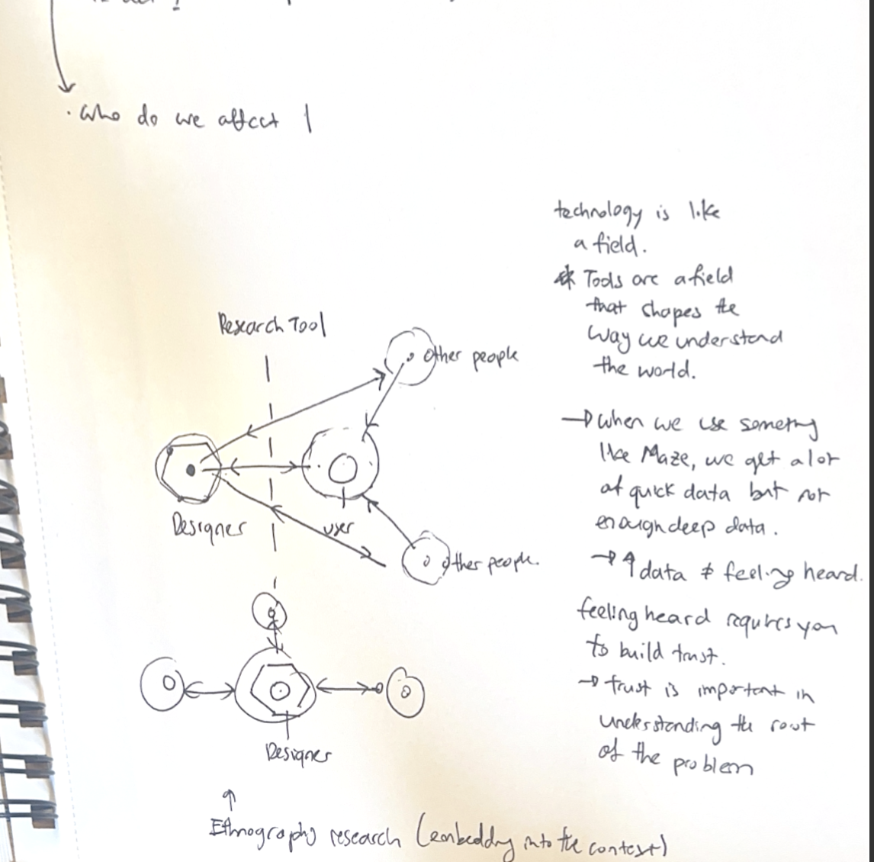
Tools shape how we understand the world
PART 3 · A HUMANITY-CENTRED LENS
More data ≠ feeling heard
Feeling heard takes trust. Trust takes people.
DESIGN RESEARCH IN THE AGE OF AI
PARKED
Notes:
This is where the talk turns from what changed to what we protect. From my fieldwork sketch. Technology is like a field: our tools shape the way we understand the world. When we use a tool such as Maze, we get a lot of quick data but not enough deep data. More data is not the same as feeling heard. Feeling heard requires trust, and trust is how we reach the root of the problem. Compare the research-tool model, in which the designer reaches users through an instrument, with ethnographic research, in which the designer is embedded in the context.

Slide 77
From social actors
to social stand-ins
SHIFT 1 — WHERE THIS IS GOING
1966 – 1994
1997 – 2025
NOW
Treated as people
→
Designed as people
→
Standing in for people
ELIZA · CASA
Clippy · Mico
Companions that can act
They begin to replace the conversations we would have with each other.
DESIGN RESEARCH IN THE AGE OF AI
PARKED
Notes:
Fast forward to 2025 and 2026, and we're seeing avatars and companions re-emerge, this time with real capabilities behind them, thanks to agents and language models. Clippy had personality without capability; today's companions have both. These emotional designs act as social actors, and they also begin to substitute for many of the social interactions we used to have with each other. That shift from treating machines as people, to designing machines as people, to machines standing in for people is where this trend is heading.

Slide 78
Behaviour changed. Work changed.
THE ARGUMENT
SHIFT 1 · BEHAVIOUR
SHIFT 2 · INTERACTION
SHIFT 3 · WORK
AI gets a body
Chat becomes the interface
Tools redraw how we work
ROOT CAUSE
UX adopted HCI's methods without its rigour.
PRESCRIPTION
Reconnect. Redefine. Lean into craft and humanity.
DESIGN RESEARCH IN THE AGE OF AI
PARKED
Notes:
Here's the whole argument on one slide. AI has changed how people behave, how they interact, and how we work. Those are three shifts: AI is getting a body, chat is becoming the interface, and our tools are redrawing how we work. Underneath all three is one root cause: UX adopted HCI's methods without its rigour. The prescription is to reconnect with that lineage, redefine our method, and lean into the craft and humanity that no tool replaces. This is the most important slide in the talk. State it plainly and slowly.

Slide 79
Three moves
ACT IV — WHAT TO DO NOW
Reconnect
Redefine
Lean into craft
Read the lineage: CASA, ELIZA, direct manipulation, Abbott, Shneiderman, Gabriel. Engage with ImpactBench and the CHI harms work.
New metrics and failure states. Prompts as interaction specs. Trust calibration as an outcome. Deep research as infrastructure.
Observe, listen, judge. Decide what you want AI to do, then build it.
DESIGN RESEARCH IN THE AGE OF AI
PARKED
Notes:
This is the takeaway slide; people will photograph it. Reconnect: read the lineage, from CASA, ELIZA, and direct manipulation to Abbott, Shneiderman, and Gabriel, and engage with ImpactBench and the CHI work on companion harms. Redefine: update our methods for probabilistic systems, with new metrics, new failure states, prompts as interaction specs, trust calibration as a design outcome, and deep research as infrastructure. Lean into craft: observe, listen, and judge what no metric can. Don't just react to what AI can do; decide what you want it to do, then build it.

Slide 80
Fiction warns.
Technology builds.
THE BLACK MIRROR EFFECT
01 · FICTION
02 · BUILDERS
03 · PRODUCTS
→
→
Raises a red flag
Read it as a brief
The warning becomes a north star
DESIGN RESEARCH IN THE AGE OF AI
BACKUP
Notes:
What we end up with is something we could call the Black Mirror effect: what fiction warns against is now built in reality. We keep seeing products that look like an episode of Black Mirror. The show is meant as a dystopian warning, a red flag. Yet some builders in Silicon Valley watch it and say, "Yes, that's what we should build." That reading is often the exact opposite of what these stories are about: we take the red flag and use it as a north star. I want to come back to this thread at the end.

Slide 81
What we're seeing right now
THREE OBSERVATIONS
01
02
03
AI gets a body
Chat becomes the interface
Tools reshape how we relate
Anthropomorphism
Conversational UX
Tools and social dynamics
DESIGN RESEARCH IN THE AGE OF AI
BACKUP
Notes:
So, what are we observing in the current age of AI? Three things: AI is getting a body; chat is becoming the dominant interface; and our tools are changing how we relate to each other, at work and beyond.

Slide 82
Tools mediate how we relate
03 — TOOLS AND SOCIAL DYNAMICS
Zoom · Slack · Google Docs · Figma
SUBSTITUTION
FRICTION
Tools stand in for what we used to rely on each other for.
Tools add confusion and disharmony between people.
The trend: more distance between people.
DESIGN RESEARCH IN THE AGE OF AI
BACKUP
Notes:
We're also seeing social dynamics change as a result of our tools, and that has happened before. Zoom, Slack, and Google Docs are good examples: the way we interact with people is often mediated through some form of technology. Sometimes these technologies help us collaborate better; Figma was a good example for designers. But the general direction I'm seeing now, at least in the research I've been reading, is that these technologies are creating more distance and more barriers between people. They do it in two ways: by substituting for things we used to rely on each other for, or by creating friction that leads to more disharmony and confusion.

